Slide 1
PROCESSES & WATER FILTERS
EG1003 | LAB 8

Slide 2
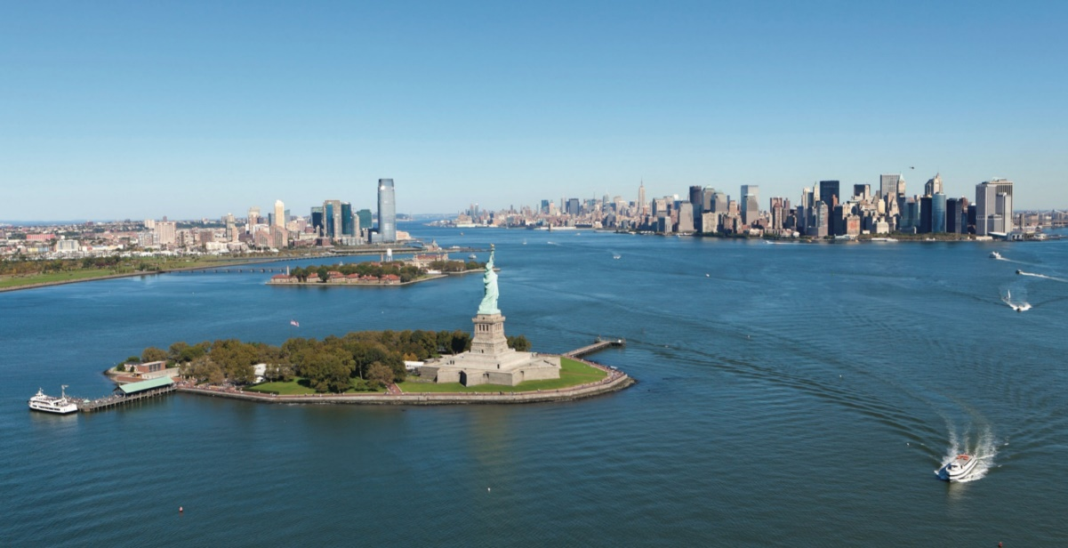
OVERVIEW
Objective
Background Information
Materials
Procedure
Assignment
Closing
Figure 1: Hudson River Courtesy of Hudson River Foundations
1

Slide 3
OBJECTIVE
To understand the processes behind a water treatment system
To design and assemble an efficient water filter
To design a process flow diagram of an industrial-scale water filter
2

Slide 4
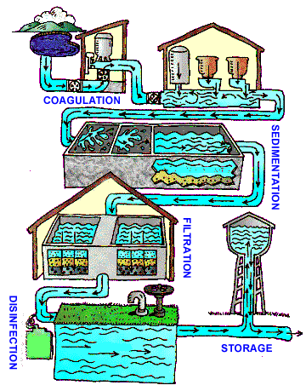
BACKGROUND INFORMATION
Water treatment system:
Coagulation & flocculation – addition of chemicals to create flocs
Sedimentation – flocs settle to bottom
Filtration – physical removal of flocs
Disinfection – kills bacteria, viruses, and parasites
Storage – store in water tank
** This lab will focus on steps 1-3 of the water treatment system
Figure 2: Water Treatment System
3

Slide 5
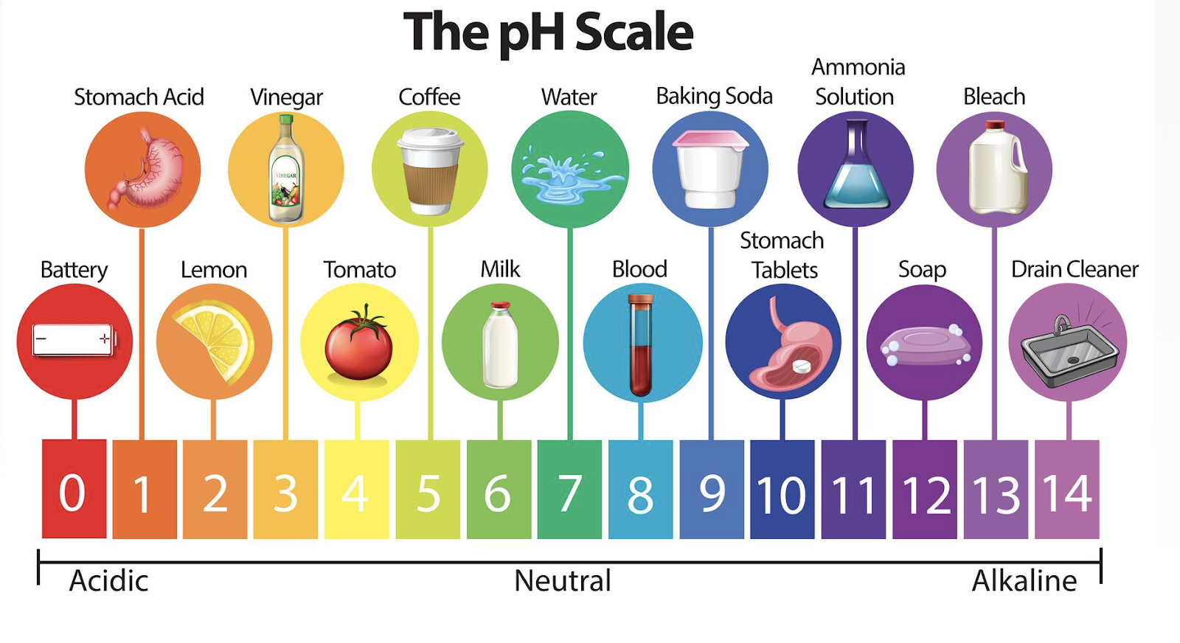
BACKGROUND INFORMATION
pH – measure of acidity and alkalinity
Logarithmic scale of concentration of hydrogen ions
Below 7 is acidic, 7 is neutral, over 7 is basic (alkaline)
Ideal pH for drinking water is 6.5 – 8.5
Figure 3: Examples of pH
4

Slide 6
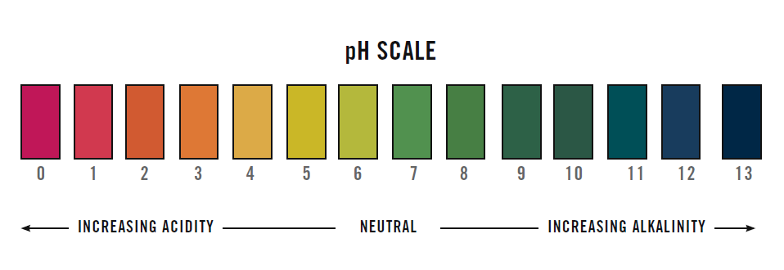
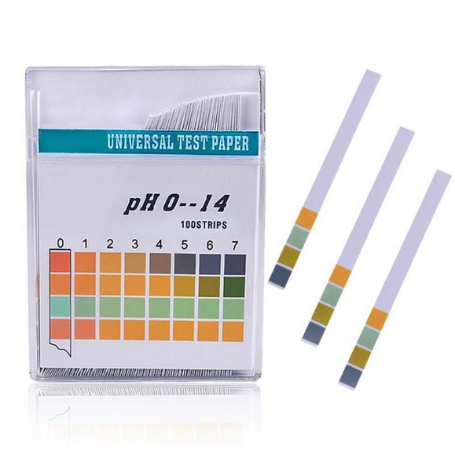
BACKGROUND INFORMATION
pH strip – strip of filter paper that changes color based on pH
Figure 4: pH Scale (Left) and pH Strips (Right)
5

Slide 7
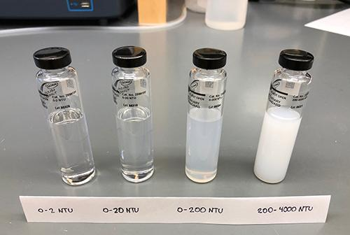
BACKGROUND INFORMATION
Turbidity
Optical characteristic of water; measure of a liquid’s clarity
Found by measuring the amount of scattered light caused by various materials in water
The higher the intensity of scattered light, the higher the turbidity due to particles in the water
Importance to Drinking Water: Microorganisms attached to particles are more likely to survive the disinfection process of water treatment systems
Figure 5: Water samples of varying turbidity
5

Slide 8
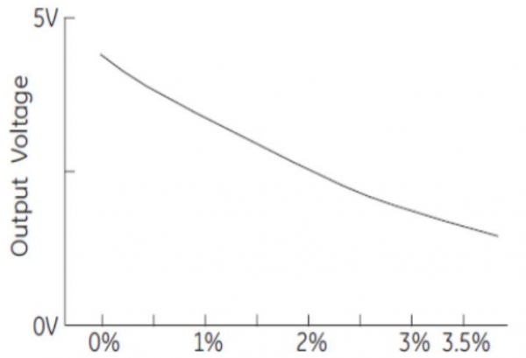
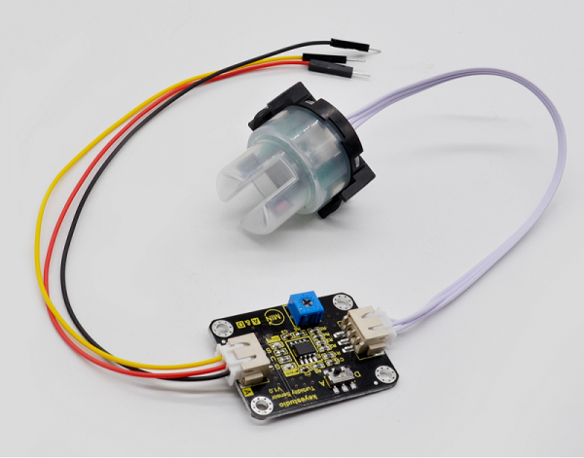
BACKGROUND INFORMATION
Turbidity Sensors
Returns the Voltage (V) of the water sample
The higher the turbidity or % scattered light, the lower the output voltage
Output Voltage (V)
% Scattered Light
Figure 6: Turbidity Sensor
Figure 7: Voltage vs. Scattered Light
5

Slide 9
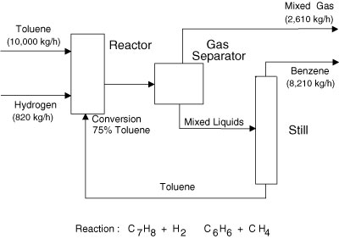
BACKGROUND INFORMATION
Process flow diagram (PFD) – relays information about a process design
Process vessel & equipment
Process and utility lines
Full energy and material balance
Composition of every stream
Bypass and recycle streams
Figure 6: Simple PFD Courtesy of InformIT
6

Slide 10
BACKGROUND INFORMATION
Mass balance – the conservation of mass applied to a process
Whatever comes in must come out
Input + Generation = Output + Consumption
Figure 7: Simple Mass Balance Courtesy of NYU
7

Slide 11
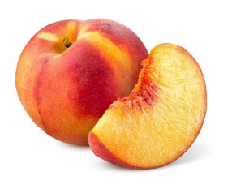
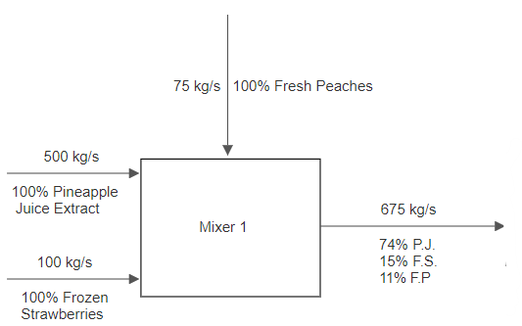
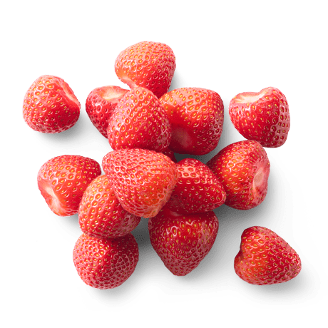
BACKGROUND INFORMATION
Example process:
Three streams enter a mixer:
500 kg/s pineapple juice
100 kg/s frozen strawberries
75 kg/s fresh peaches
Figure 8: First Process Unit Example
8

Slide 12
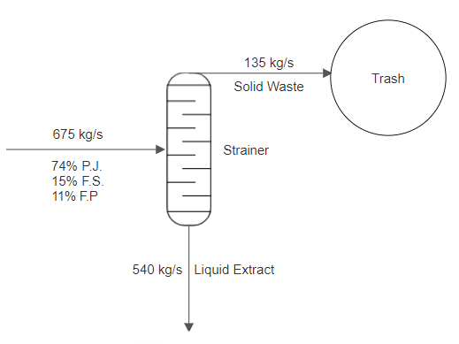
BACKGROUND INFORMATION
Next, product stream enters a strainer:
20% exits as solid and goes into the trash
80% exits as liquid extract
Figure 9: Second Process Unit Example
9

Slide 13
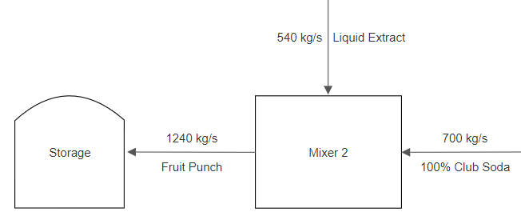
BACKGROUND INFORMATION
Lastly, liquid extract enters another mixer with another stream:
700 kg/s club soda
Product stream then enters storage unit
Figure 10: Third Process Unit Example
10

Slide 14
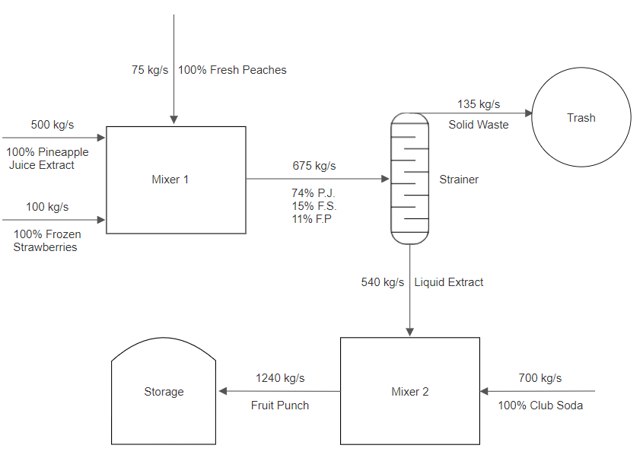
BACKGROUND INFORMATION
Combine all the parts to make the complete PFD
Figure 11: Complete Process Flow Diagram Example
11

Slide 15
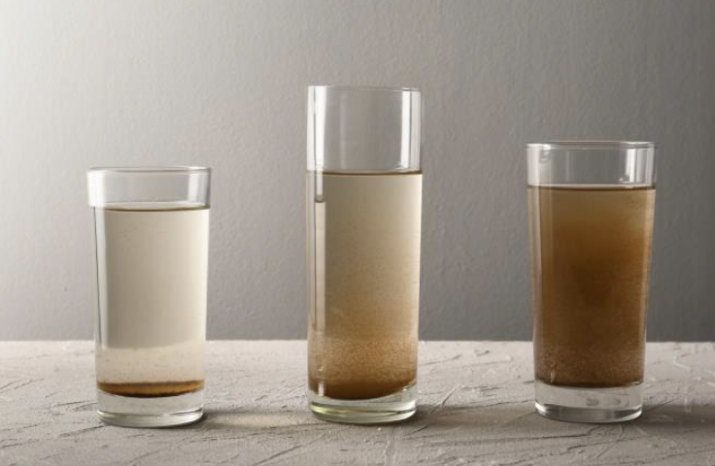
MATERIALS
Lab PC
pH strips
Contaminated water
Beaker
Funnel
Erlenmeyer flask
Scale
Alum
Sodium bicarbonate
Glass stirring rod
Gravel
Sand
Activated carbon
Turbidity Sensor
Figure 12: Turbid Water Example
12

Slide 16
PROCEDURE
Part 1: Water filter design analysis- Excel exercise
Part 2: Initial Data
Part 3: Balance the pH of the contaminated solution
Part 4: Flocculation and coagulation
Part 5: Water filter design and assembly
Part 6: Process flow diagram
13

Slide 17
DESIGN CONSIDERATIONS
Water filter design is judged by a Competition Ratio (CR):
Design must include at least 3 scoops but no more than 6 scoops
Design must include no more than 3 scoops of each material
Only 1 Trial is allowed
14

Slide 18
DESIGN CONSIDERATIONS
Table 1: Cost List for Water Filter Design
Material | Unit | Cost Per Unit
Gravel | 1 scoop | $0.25
Sand | 1 scoop | $1.00
Activated Carbon | 1 scoop | $0.50
15

Slide 19
ASSIGNMENT
Team lab report:
Answer discussion questions in manual
Include pictures of water filter design & assembled water filter
Include Excel datasheet with results
Include picture of complete process flow diagram
Due at 11:59 PM the night before Lab 9
Team presentation:
Address discussion points in manual
Include cost of water filter designs
16
Notes:
This is their first team lab report, make sure to ask if they have any questions.

Slide 20
CLOSING
Record all data in Excel datasheet
Take pictures of the filter design, assembled water filter, contaminated water, filtered water, and process flow diagram
Submit all work electronically
Clean up workstations
Return all unused materials to the TA
17

Slide 21
QUESTIONS?

