Slide 1

COMPUTER-AIDED DESIGN (CAD) COMPETITION
EG1003 | LAB 4

Slide 2


OVERVIEW
Objective
Background Information
Materials
Procedure
Competition Rules
Assignment
Closing
Figure 1: Fusion 360 (left) and Revit (right) icons
1

Slide 3
OBJECTIVE
Use CAD software, Fusion 360 and Revit, to visualize a design
Analyze and modify a poorly-designed part in Fusion 360
Enter the modified part in a competition against other redesigns
Design an apartment using Revit
2

Slide 4
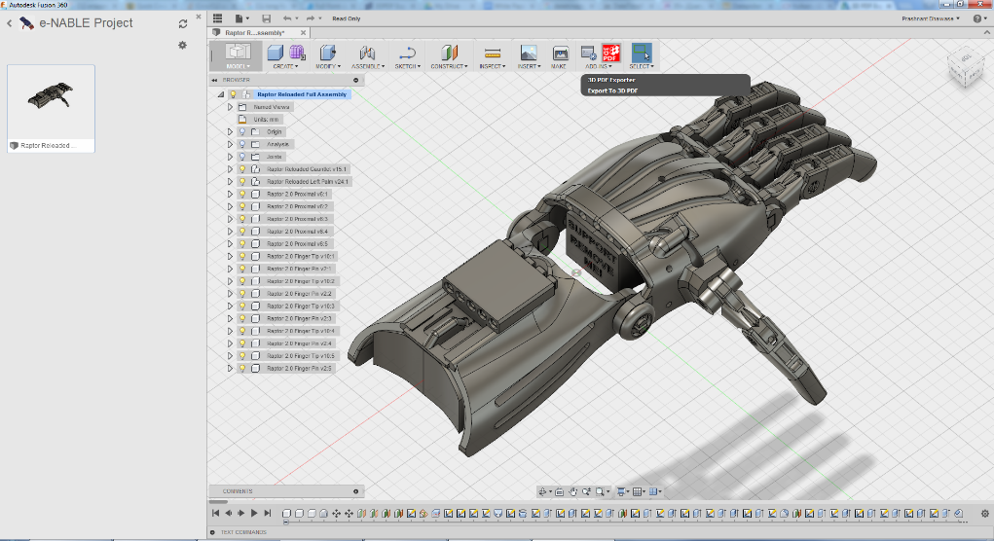
BACKGROUND INFORMATION
Fusion 360
  Introduced in “Introduction to 3D Printing”
  Cloud-based 3D modeling software
  Used for computer-aided design (CAD), computer-aided manufacturing (CAM), renderings, animations, etc.
Figure 2: Fusion 360 in use courtesy of Autodesk
3

Slide 5
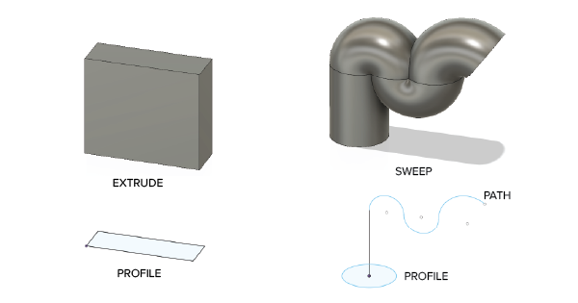
BACKGROUND INFORMATION
Design workspace
  Used to make precisely-scaled drawings of engineering designs
  Sketch a 2D profile
  Generate 3D body using Sweep or Extrude
Figure 3: Extrude and Sweep tools
4

Slide 6
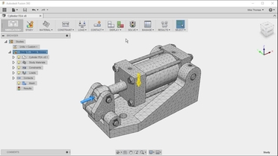
BACKGROUND INFORMATION
Simulation workspace
  Used to run structural analysis on model under real-world conditions
  Define the constraints (boundary conditions) on the model
  Apply a load to simulate real-world force
  Generate a mesh, an array of polygons making up the body of the model
Figure 4: Fusion 360 mesh courtesy of O’Reilly
5

Slide 7
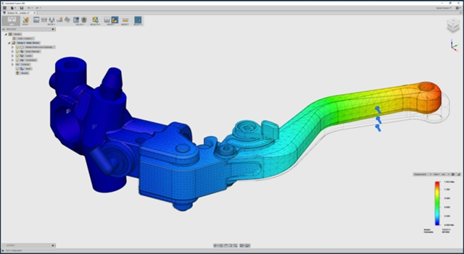
BACKGROUND INFORMATION
Simulation workspace
  Run simulation to obtain safety factor, a value used to describe how much stronger a system is than the expected load
  Can determine if an object is ready to sustain real-world loads or needs to be remodified
Figure 3: Fusion 360 simulation courtesy of Engineering.com
6

Slide 8
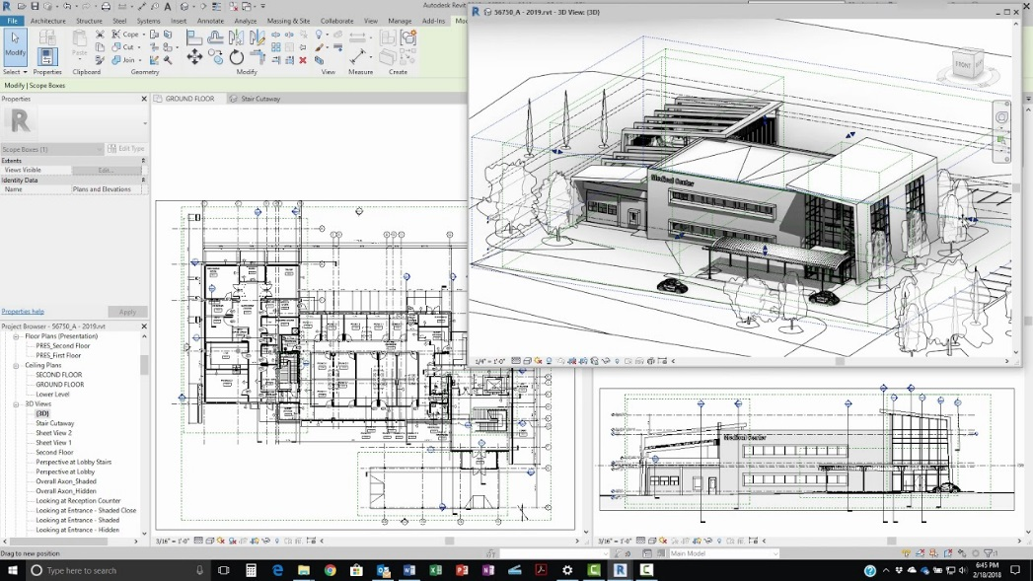
BACKGROUND INFORMATION
Revit
  Building modeling software for architects and civil engineers
  Creates homes, buildings, and structural support systems
  Used to create floor, plumbing, electrical, and HVAC plans
Figure 4: Revit in use courtesy of Revit News
7

Slide 9
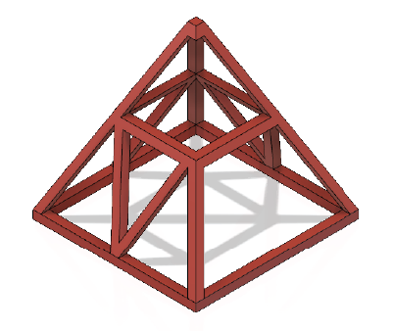
MATERIALS
A lab PC
Fusion 360
Revit
Predesigned part files (download
directly from the manual)
Figure 5: Truss Pyramid
8

Slide 10
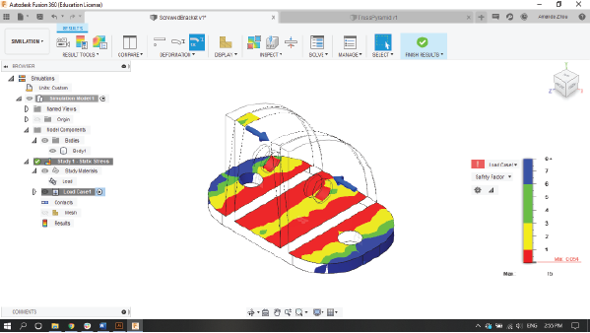
PROCEDURE
Fusion 360
  Find the load, material, and
  constraints on the model
  Run a static stress simulation
  Review the initial factor of safety
  Modify the model in the Design workspace within the limits of the competition rules
  Rerun simulations and remodify until
  the part has safety factor of at least 3
  Save and store the F3D file for later use
Figure 6: Screwed bracket static stress simulation
9

Slide 11
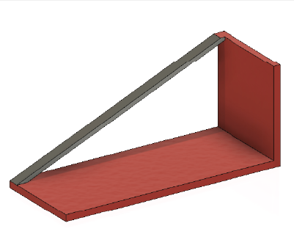
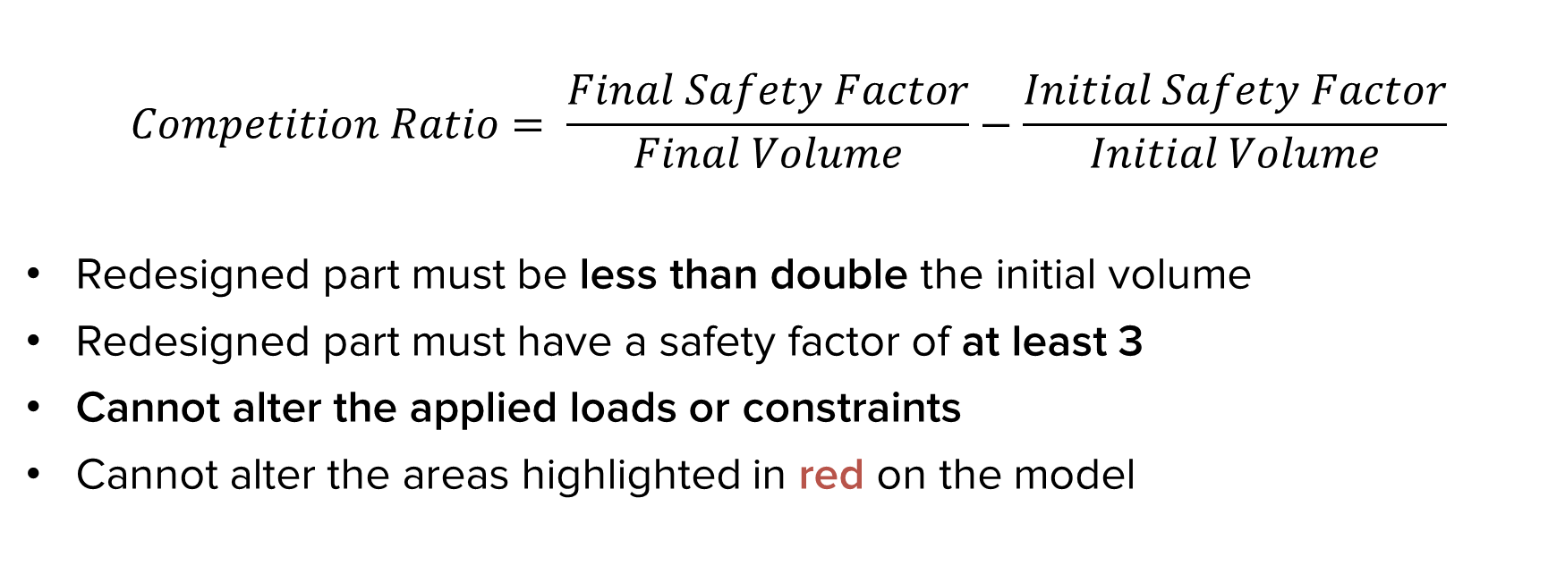
COMPETITION RULES
$$Competition Ratio= \frac{Final Safety Factor}{Final Volume}−\frac{Initial Safety Factor}{Initial Volume}$$
Redesigned part must be less than double the initial volume
Redesigned part must have a safety factor of at least 3
Cannot alter the applied loads or constraints
Cannot alter the areas highlighted in red on the model
Figure 7: Wire
Supported Shelf
10

Slide 12
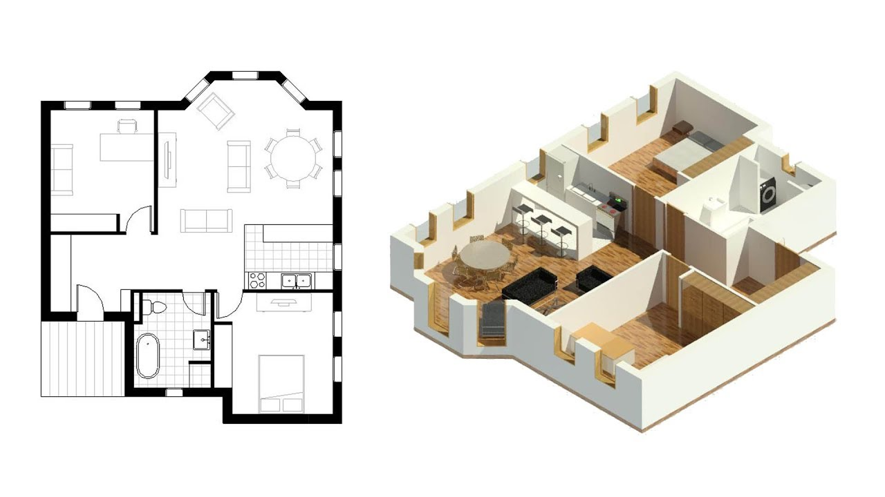
PROCEDURE
Revit
  Create a 350 – 400 square foot apartment for residents/college students
  Contains one of each: bathroom, kitchen, bedroom with bed, table, and desk
  Must have adequate lighting (at least one window) and space
  An electrical plan for the entire apartment
Figure 7: Small apartment in Revit courtesy of Balkan Architect
11

Slide 13
PROCEDURE
Revit
  Extra credit: Create a 3D rendering and walkthrough video of the apartment
  Submit RVT file to the EG1003 website before the end of lab
Figure 7: Small apartment in Revit courtesy of Balkan Architect
12

Slide 14
ASSIGNMENT
Individual lab report:
  Answer discussion questions in manual
  Include screenshots of at least two simulations
  Include screenshots of apartment design
  Due at 11:59 PM the night before Lab 5
13

Slide 15
ASSIGNMENT
Team presentation:
  Address discussion points in manual
  Include drawings (top, front, most detailed side, isometric) of
  unmodified and modified part
  Include screenshots of apartment design
  Include 3D rendering and walkthrough video for extra credit
  Milestone presentation is next week
  CAD Competition presentation is due the following week
14

Slide 16
CLOSING
Share tasks – each team member should take a turn using the software
Have all original data signed by a TA
Submit all work electronically
Take screenshots of mechanical part and apartment
Extra credit for 3D rendering and video walkthrough of the Revit apartment
  Must include in the team presentation to get extra credit
Lab report due next week, presentation due the following week
15

Slide 17
QUESTIONS?

