Slide 1
Electronic Filters
Notes:
L.Mexhitaj 2009

Slide 2
Overview
Objectives
Background
Materials
Procedure
Report / Presentation
Closing

Slide 3
Objectives
Learn about electrical filters
Different types
Uses
What is the -3dB point?
Create filters and a crystal set radio using multiple circuit elements
Identify filters based on generated graphs

Slide 4
Frequency Response Graph
Gain (in dB)
Ratio of output against input
20*log (V_{out}/V_{in})
Always negative value
-3dB Point
3dB drop of signal power from highest point on gain
Signal power is half of original value
Cutoff Frequency (in Hz)
Frequency at -3dB Point

Slide 5
Frequency Response Graph
Plot of Gain versus Frequency of electrical signal
Semi-logarithmic scale
Linear Y-axis, logarithmic X-axis
Max Gain (dB)
Gain (dB)
(linear scale)
Gain is 3 dB lower than the max
3 dB
Bandwidth
f (kHz) (log scale)
Cutoff Frequency
Gain vs. Frequency

Slide 6
What are Filters?
Eliminate unwanted frequencies
High-pass or low-pass
Favor desired frequencies
Band-pass
Bandwidth: frequency range filter allows to pass
Example
Radio tunes in to particular station

Slide 7
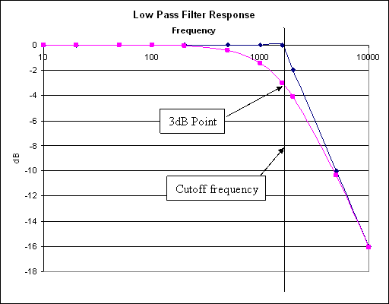
Basic Filter Types
Low-Pass
High-Pass
Band-Pass
Low-Pass Filter
Low frequencies pass
IGNORE
3dB Point: -3dB
Cutoff Frequency:
1590 Hz
Bandwidth: 0 - 1590 Hz
PASS

Slide 8
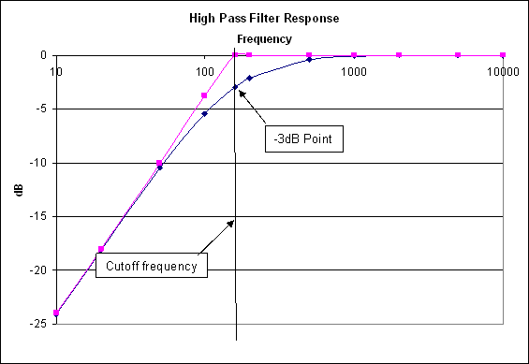
Basic Filter Types
Low-Pass
High-Pass
Band-Pass
High-Pass Filter
High frequencies pass
IGNORE
3dB Point: -3dB
Cutoff Frequency:
160 Hz
Bandwidth: 160 - ∞ Hz
PASS

Slide 9
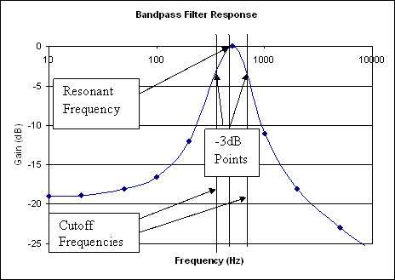
Basic Filter Types
Low-Pass
High-Pass
Band-Pass
Band-Pass Filter
Limited frequency range passes
IGNORE
IGNORE
3dB Point: -3dB
Cutoff Frequencies:
400 and 600 Hz
Bandwidth: 400 - 600 Hz
Resonant Frequency (High Response Point):
500 Hz
PASS

Slide 10
Electrical Terminology
Terms
Elements
Wiring
Voltage (V) [unit = V for Volts]
Potential difference in electrical energy
Current (I) [unit = A for Amperes]
Charge flow rate
Can be positive or negative

Slide 11
Electrical Terminology
Terms
Elements
Wiring
Symbol
Resistor (R)
[unit = Ω for Ohms]
Resists flow of electrical current
Dissipates electrical energy as heat
Often used to alter voltages in circuits
Characterized by Ohm’s Law: V = I*R
Not sensitive to frequency
Uses a poor conductor
Example: Carbon

Slide 12
Electrical Terminology
Symbol
Terms
Elements
Wiring
Capacitor (C) [unit = F for Farads]
Stores potential energy (V)
Affected by voltage and frequency
A pair metal plates separated by non-conductive material
Example: Air
Electrical charge accumulates on plates

Slide 13
Electrical Terminology
Symbol
Terms
Elements
Wiring
Inductor (L) [unit = H for Henries]
Stores and delivers energy in a magnetic field
Magnetic fields affect the current of a circuit
Effected by current and frequency
Is a coil of wire
Notes:
Needs to be fixed

Slide 14
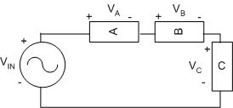
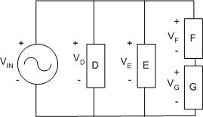
Electrical Terminology
Terms
Elements
Wiring
Series
Same current through
all elements
Vin = VA + VB + VC
Parallel
Same voltage across
all branches
Vin = VD = VE = VF + VG

Slide 15
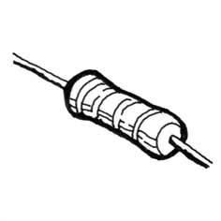
Materials for Lab
Resistors
Brown, black, yellow = 100KΩ
Brown, black, green = 1MΩ
Capacitors
102 = 0.001 µF
10J = 10pF
Inductors
1mH

Slide 16
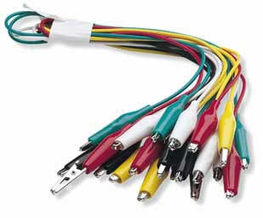
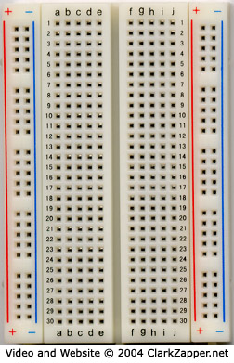
Materials for Lab (Cont’d)
NI-ELVIS II+
Breadboard
Coaxial to Alligator Clip Cable

Slide 17
Procedure - Testing
Plug in NI ELVIS II to PC Lab and turn it on
Select NI ELVISmx Instrument Launcher
Select FGEN in the Instrument Launcher
Set function generator to 1000Hz
Set the amplitude to 2 Vpp
Set signal route to FGEN BNC
Select Scope in the Instrument Launcher

Slide 18
Procedure – Data Analysis
Click run in both instruments
Calculate the -3dB point.
Test both of the circuits and determine their type
Assemble the radio

Slide 19
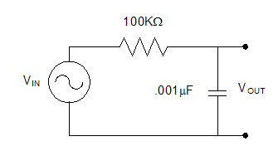
Procedure - Circuit 1
Connect the 100kΩ resistor and .001 µF capacitor in series

Slide 20
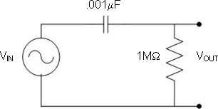
Procedure - Circuit 2
Connect 0.001 µF capacitor to 1 MΩ resistor in series

Slide 21
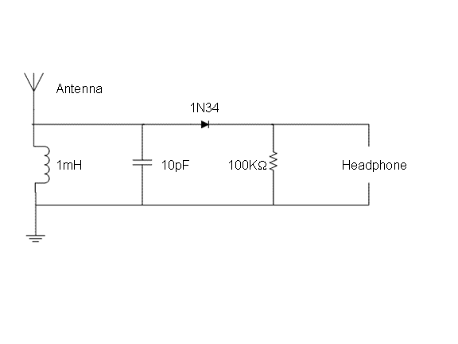
Procedure - Circuit 3
Assemble the circuit below (Crystal Radio)

Slide 22
Assignment: Report
Individual Report (one report per student)
Title page
Discussion topics in the manual
For first two circuits
Include Excel tables and Gain vs. Frequency graphs
Determine filter type
Label each graph with determined filter type
Have TA scan in signed lab notes
OPTIONAL- Include photos of circuits and setup

Slide 23
Assignment: Presentation
Team Presentation
Include lab data
Professional-looking tables
Discussion topics in the manual
Include photos of circuits and setup
Refer to “Creating PowerPoint Presentations” found in Online Manual

Slide 24
Closing
TA will assign which circuit you start with
Have all original data signed by your TA
All team members must actively participate in experiment
Submit all work electronically
Return all materials to your TA

