Slide 1

RECITATION 6
EG1004

Slide 2
AGENDA
Engineering Ethics, Inclusion & Accessibility
Data is Your Argument
Presentation Activity
Lab 5 Presentations
1
Notes:
Agenda for the day --

Slide 3
ENGINEERING ETHICS
Technology & engineering design raise ethical & social questions
Your technical perspective and voice will be important
You must work with policy-makers, business leaders, and the public
National Society of Professional Engineers Code of Ethics (https://www.nspe.org/resources/ethics/code-ethics)
  Fundamental Canons
  Rules of Practice
  Professional Obligations
7
Notes:
Regardless of what discipline you study or career you pursue, your profession will have a code of ethics to follow. Creating, implementing, and regulating these codes of ethics is an ongoing process that engineers, policymakers, and other stakeholders participate in. As you develop your engineering identity, considering these ethical impacts – the social/societal impact of your work – in your design can strengthen your work.

Slide 4
What role does your major/discipline play in society?
What ethical & social issues arise from the implementation of the technologies you might create?
THINK-PAIR-SHARE
2
Notes:
Building a sense of ethics/social responsibility takes reflection! First, what role do you see your major/discipline playing society? What ethical social issue arise from your work?

Slide 5
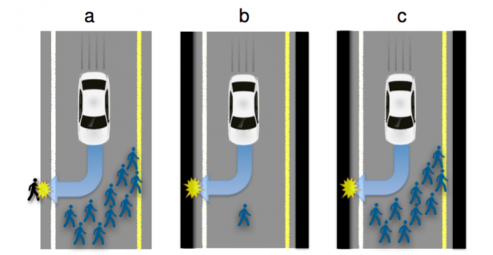
CASE SCENARIO: AUTONOMOUS VEHICLES
Who decides the value of human lives?
Figure 1: Traffic situations with inevitable harm (MIT Tech Review)
2
Notes:
Let’s us this case scenario, as an example.
Consider the following case scenario, a reworking of the trolley problem: https://www.technologyreview.com/2015/10/22/165469/why-self-driving-cars-must-be-programmed-to-kill/

Slide 6
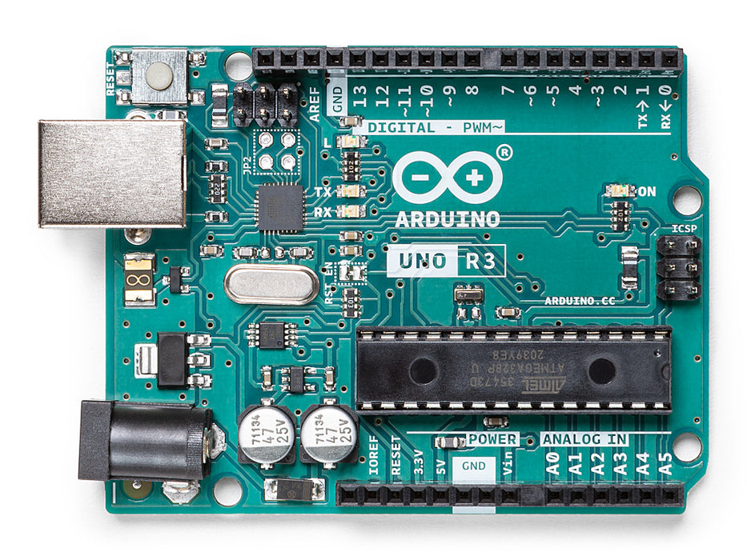
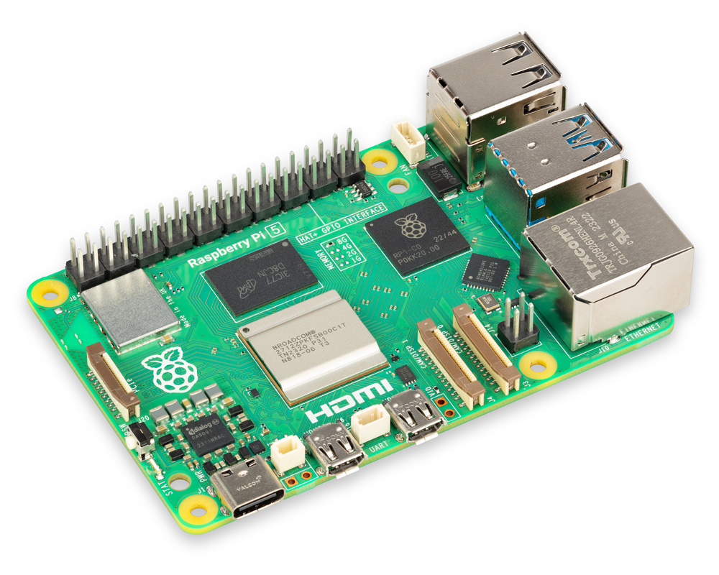
INCLUSION +ACCESSIBILITY
Designing with inclusivity in mind can lead to accessible innovations – technologies that can be used by a wide range of people
For example: consider the impact of tools like Arduino, Raspberry Pi, 3D printers, etc. in this course – open source, cost-effective and beginner friendly
There is always more to learn and improve!
7
Notes:
Like we discussed in lecture – everyone & everything is biased, and tackling these biases take effort. This effort has a high payoff – inclusivity leads to accessible design, or in other words tech that can be used by a wide range of people. Consider the Arduino and Raspberry Pi microcontrollers you are using for you projects – these cost-effective, beginner friendly tools have made prototyping accessible to a much broader range of ppl.

Slide 7
Consider your SLDP project.
Who are you designing your project for?
What biases might you have in your design process, and how might you tackle them?
THINK-PAIR-SHARE
4

Slide 8
PRESENTATION ACTIVITY
Following each presentation, all teams discuss and share one effective aspect and one improvement for the group that just presented
8
Notes:
From lab 5 presentation onward, ask students to share feedback with each other following each presentation. Students discuss the feedback within their groups.

Slide 9
QUESTIONS?

