Slide 1

INTRODUCTION TO THE SEMESTER-LONG DESIGN PROJECTS (SLDPs) (VIRTUAL)
EG1003 | RECITATION 1

Slide 2
AGENDA
Project Introduction
Project Grading
SLDP Options
Closing
Questions
1

Slide 3
PROJECT INTRODUCTION
10
Week Project
Three Project Types:
Housing & Innovation in Revit (HIR)
Biomedical Device (BMD)
Rapid Assembly & Design (RAD)
2-4
Team Members
2

Slide 4
PROJECT GRADING
Item | Percentage of Grade
Benchmarks & Commissioning | 50%
Final Presentation | 50%
The SLDP is 30% of your total course grade!
3

Slide 5
PROJECT GRADING
Benchmark
B
Benchmark
A
Benchmark A
Benchmarks
Two benchmarks
Completion of certain portions of project
Due dates on schedule on eg.poly.edu
Penalties for late completion
Extra credit for early completion
Benchmark B
4

Slide 6
PROJECT GRADING
Benchmark A
Benchmark B
Commissioning
Submission
Commissioning
Completion of all tasks
Due date on schedule on eg.poly.edu
Can partially commission if unable to complete all tasks on time
Submission
Submission of all SLDP material
Due on same date as commissioning
Can submit early for extra credit
5

Slide 7
SLDP OPTIONS
Housing & Innovation in Revit (HIR)
Create 3D Revit model of campus extension to NYU Tandon
Include plumbing & electrical plans
Obtain LEED Gold certification
Figure 1: 181 Mercer Street Building Courtesy of NYU
6

Slide 8
SLDP OPTIONS
Benchmark A
Benchmark B
Commissioning
One recreational space
All classroom spaces
Floor plans for all floors (six minimum) and front elevation
One 20 person-classroom
One 40 person-classroom
Facility of choice
Electrical & plumbing plans for dorm
LEED Gold and implementation plan
Housing & Innovation in Revit (HIR)
Extra Credit
LEED Platinum certification
7

Slide 9
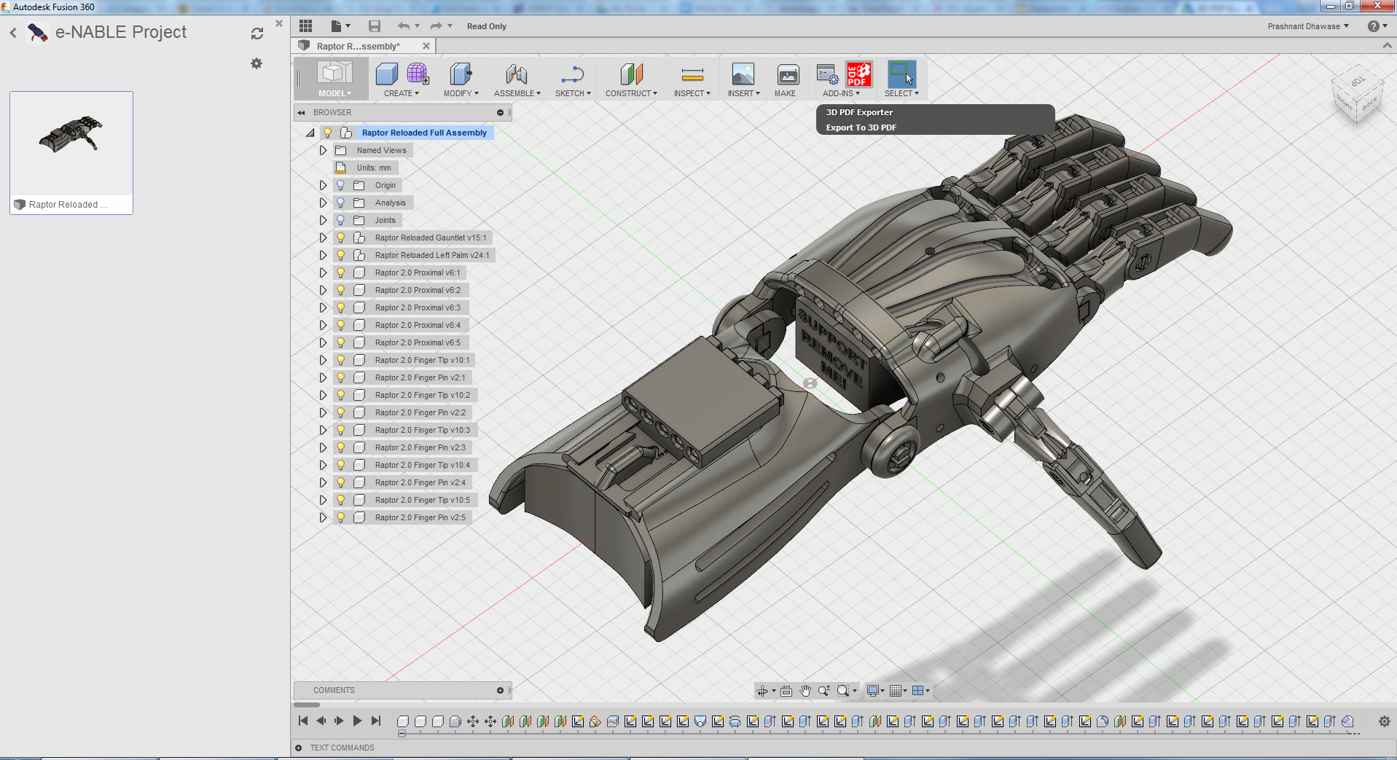
SLDP OPTIONS
Biomedical Device (BMD)
Create an autonomous prosthetic limb or wearable device
Device achieves three tasks
Model design with CAD
Simulate circuitry using Fritzing
Engineering notebook
Figure 2: Prosthetic Hand Courtesy of Autodesk
8

Slide 10
SLDP OPTIONS
Benchmark A
Benchmark B
Commissioning
Determine device choice
Updated CAD model
Final CAD model
Initial CAD model
One completed task
Two completed tasks
Three completed tasks
Circuit & schematic diagrams
Biomedical Device (BMD)
Extra Credit
Complete extra tasks
9

Slide 11

SLDP OPTIONS
Rapid Assembly & Design (RAD)
Identify a problem or address a proposed problem
Develop a solution
Manufacture a proof of concept
$100 budget
  Theoretical budget
Additional resources: EG1003 workshops, Open Lab, RAD Mentors
Figure 3: SpeakSign RAD Project
10

Slide 12
SLDP OPTIONS
Benchmark A
Benchmark B
Commissioning
Design & Feasibility Report (DFR)
Updated CAD model
Final Design Report (FDR)
Initial CAD model
Final CAD model
Rapid Assembly & Design (RAD)
Extra Credit
Additional functionalities as determined by RAD Mentor
11

Slide 13
CLOSING
Which projects interest you?
Refer to manual.eg.poly.edu for full project information
Speak with Professors and TAs for information regarding projects
12

Slide 14
QUESTIONS?

