Slide 1

SAFETY GUIDELINES
EG1003 | LAB 1

Slide 2

WHAT IS SAFETY?
To protect life and property from harm
or damage
Safety protects:
  Personal well-being
  Public well-being
  Proper business environment
Figure 1: Safety Things Courtesy of
CYB Human Resources
1

Slide 3
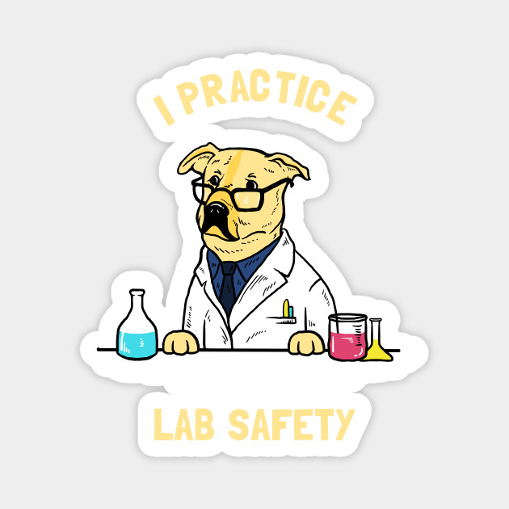
NEED FOR SAFETY
Helps maintain a hazard-free workplace
Creates a comfortable workplace
Keeps order and responsibility
Figure 2: Safety Dog Courtesy of TeePublic
2

Slide 4

SAFETY STAFF
General Engineering
  Head TAs, RH 303B, x3515
Tandon School of Engineering
  Charles Martucci, RH 701E, x3613
  Nicole Romeo, 370 Jay St 2nd Floor, x85335
3

Slide 5
EMERGENCY NUMBERS
Contact | Phone Number
Emergency Closings | (212) 998-1220
Guard Stations | Rogers Hall: (646) 997-3537 Dibner: (646) 997-3727
Public Safety | (212) 998-2222
Wellness | (212) 443-9999
Facilities & Operations | (212) 998-1001
Environmental Health & Safety | (212) 998-1450
4

Slide 6

BASIC SAFETY RULES
Know your peers and TAs, do not admit
strangers into the Zoom call
Be courteous
  Mute your microphone if there is
  excessive background noise
  Maintain a business environment
  Never work alone
  Don’t talk over the TAs or other
  students
5

Slide 7
RECAP
Know & follow the safety rules
Report any problems to the safety staff
Maintain a business environment
THINK
SAFETY
ALWAYS………..
6

Slide 8
QUESTIONS?

