Slide 1

RECITATION 10
EG1004

Slide 2
AGENDA
Lab 11 Presentation Assignment
Career Building
Activity: Elevator Pitches
Resumes Revisited
Milestone 3 Presentations
Design Pitch Activity
1

Slide 3
LAB 11 PRESENTATION ASSIGNMENT

Slide 4
LAB 11 PRESENTATION ASSIGNMENT
Author a presentation using (nearly) all images
Where text is allowed:
  Title slide
  Overview slide
  Materials slide
  Captions for figures, tables, and equations
  Suspect list/table
  Data tables
  References to suspect names
  Slide titles
3

Slide 5
CAREER BUILDING

Slide 6
REFLECTION QUESTIONS
Who are you as a professional?
Why do you want to be an engineer?
What would you like to do each day at work?
What would you like to accomplish professionally?
What are your financial goals?
3

Slide 7

TYPES OF SECTORS
6

Slide 8
TYPES OF SECTORS
  Government Contractors
  Consulting Firms
  Startups
  Non-Profit Organizations
  …the list goes on!
  Government Agencies
  Government Labs
  (Local, State, Federal)
6

Slide 9

HOW TO GET A JOB
Tandon Career Services
  Tandon Career Fair
  Tandon Resources
The Wasserman Center | Brooklyn
  NYU Handshake
LinkedIn, Glassdoor
Figure 1: Wasserman Center location -- Wunsch Hall in MetroTech courtyard
4

Slide 10
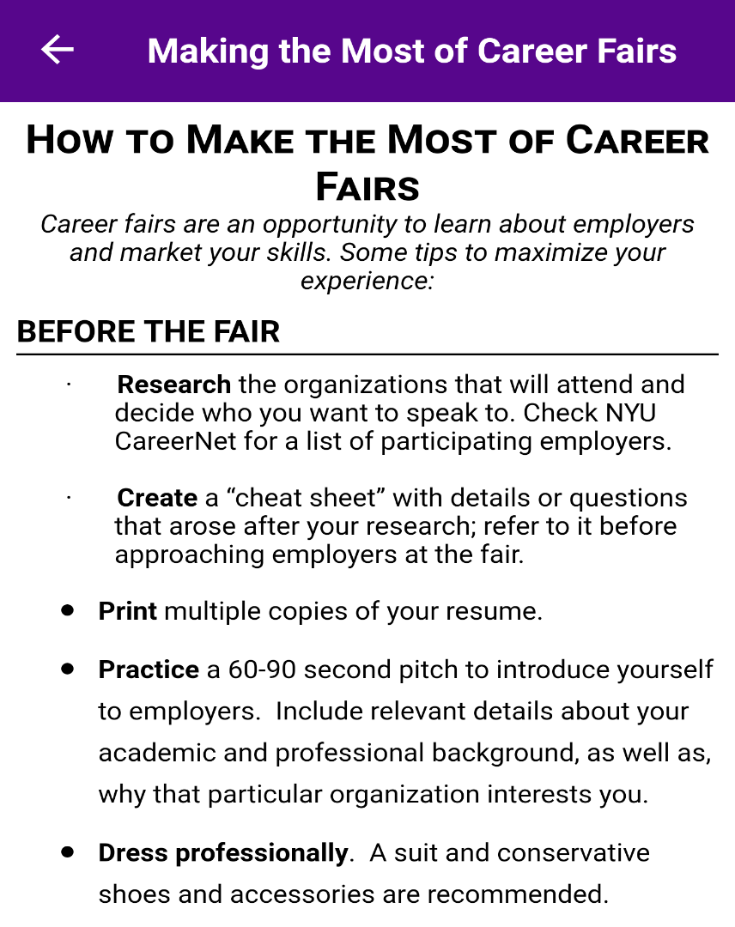


TANDON CAREER FAIR
Figures 2 & 3: Tandon Career Fair logo and tips
5

Slide 11
TYPES OF JOBS
Internships, Co-Ops
  Your number 1 priority!
Teaching Assistant
  EG 1004 Intro to Engineering
  MakerSpace
  Other Tandon courses
  K-12 summer STEM programs
Research Assistant
  Undergraduate Summer Research
  5 to 10 hours per week during semester
Future Labs Intern
  12 hours per week, 3 credits
7

Slide 12
RESUME BUILDING
Include examples that set you apart
Focus on your
  Work ethic and being detail oriented
  Networking and professional societies
Keep it concise (ONE PAGE )
Sections
  Education, Experience, Skills, Awards, Activities
8

Slide 13
PROFESSIONAL EMAILS
Opening Salutations – “Dear Ms. Williams,”
Put your name in the subject (and everywhere)
  Doe, Jane Application
Your email should be firstname.lastname@nyu.edu
Proofread
  Complete sentences & proper grammar
  Do not add email address until you proofread
Closing Salutations – “Thank you for your consideration,”
Attachment names
  Use your name: Doe, Jane Resume.pdf
Always Reply All on Emails!
Link to change NYU email alias
9

Slide 14
ACTIVITY

Slide 15
ACTIVITY
DEVELOP AN ELEVATOR PITCH
Imagine you are talking to a recruiter from your favorite company at a career fair & use your EG 1004 project to sell yourself.
11
Notes:
**Give the partners several minutes to complete the activity. Ask one or two members to share if desired.**

Slide 16
Design Pitch Exercise
CATME Peer Evaluations II
Submission of Cover Letter & LinkedIn
MILESTONE 3 CHECK

Slide 17
CRAFT YOUR DESIGN PITCH

Slide 18
DESIGN PITCH
What are you trying to do?
NO JARGON
What are the limits of current practice?
What’s new in your approach?
Who cares?
What impact will success have?
What are the risks and payoffs?
How much will it cost?
How long will it take?
How will success be measured?
11
Notes:
**Give the partners several minutes to complete the activity. Ask one or two members to share if desired.**

Slide 19
QUESTIONS?

