Slide 1

DATA IS YOUR STORY
EG1003 | RECITATION 5

Slide 2
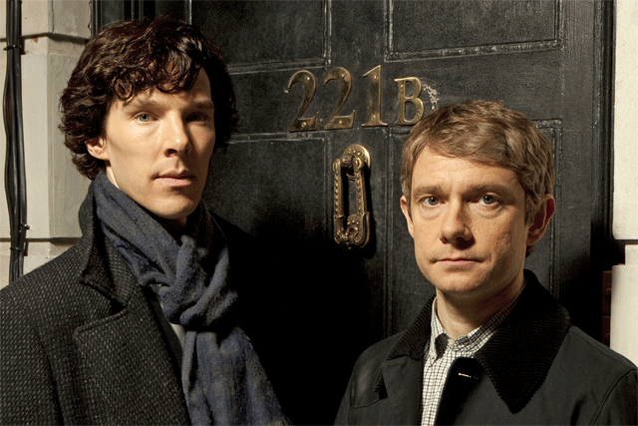
WHAT ARE OBSERVATIONS?
Measured data
Data in the form of well-labeled tables, graphs, photos, and other illustrations
Recorded without analysis
Objective description
What was observed
Figure 1: Holmes & Watson Courtesy of BBC Sherlock
1

Slide 3
DATA AND OBSERVATIONS
Present data, do not analyze data
Past tense
Picture(s) of dissected products, labeled “Figure 1: Nerf Gun”
Power supply/energy source, primary motion, energy flow, form outer body
Other labs – present data
Competition results, labeled “Table 1: Competition Results”
Discuss trial results and competition results
Pictures and discussion of other competitors, also labeled
2

Slide 4
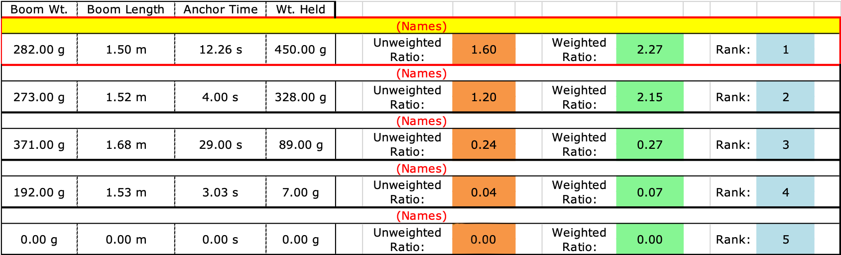
DATA AND OBSERVATIONS
Table 1: Boom Construction Competition Ranking
3

Slide 5
DATA AND OBSERVATIONS
Figure 1 shows the boom was built using two thick dowels, two thin dowels, four 3D-printed dowel connectors, and Kevlar string.
It had a boom weight of 269 g, a boom length of 1.51 m, an anchor time of 101 s, and held 450 g. Its unweighted ratio was 1.67 and its weighted ratio was 0.77. It placed fourth in the competition (Table 1).
4

Slide 6
QUESTIONS?

