Slide 1


THE ART OF THE
COVER LETTER
EG1004 | RECITATION 8

Slide 2

What is a Cover Letter?
Cover letter: letter of interest for job posting
    Addressed to hiring manager/supervisor
    States interest $ relevant experience
    1 page maximum
    Can be required in addition to a resume
    Tells why you are the best candidate
Figure 1: Courtesy of Michael Burrows

Slide 3
Resume vs. Cover Letter
What is the difference?
    Resume
        Lists all of your education, professional experience, and skills
        Comprehensive overview of education/jobs/qualifications
    Cover letter
        Written in full sentences & tells your story
        Highlight career experiences that may not fit into a resume
        Cover letters do not need to cover every professional experience

Slide 4
Cover Letter Format
Company address, hiring manager name, & hiring manager title
Greeting: (Dear [insert name of hiring manager/supervisor],)
Introductory paragraph
  What position are you applying for?
  How did you find this position? Were you referred?
1 paragraphs detailing relevant experiences/skills
1-2 paragraph detailing what you bring to the job
Sign off/signature (Sincerely, [insert name])

Slide 5
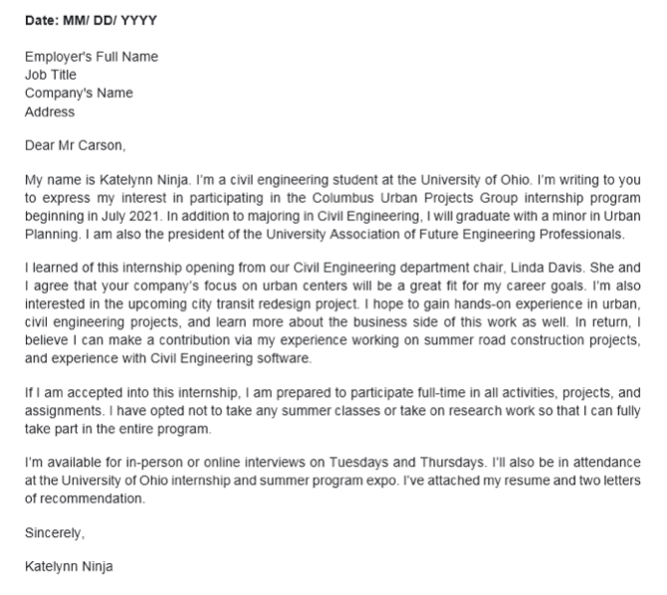
Sample Cover Letter
Figures 2A: Full cover letter courtesy of Cover Letter Ninja
Figures 2B: Cover Letter Body courtesy of Cover Letter Ninja

Slide 6
Cover Letter Best Practices
Professional and polished: conveys professional, confident tone
No grammar/spelling errors!
Tailored specifically to the company and position
Pulled from most relevant previous experiences
Highlights responsibilities, skills, or experiences that qualify you for the job
Specific yet brief
Shares specific examples of numbers, metrics, or achievements

Slide 7
The Best Cover Letters…
Discuss how you add value
Companies want what value you will add
Do not focus on the value to your career
    Yes: “I believe I can add value to your infrastructure projects through my experience as a civil engineering intern.”
    No: “I want to learn more about civil engineering projects through your company.”
1 page maximum:
3-4 short, easy to read paragraphs max

Slide 8
Cover Letter Editing Activity
Microsoft, Seattle, Washington
January 1, 2022
To Whom It May Concern:
My name is Taylor Swift, and I am thrilled to apply for the Software Engineering Internship at Microsoft this summer. I was referred to the open position by my computer science professor at NYU Tandon, Dr. John Doe, who has been my academic advisor for the past two years.
As an undergraduate at NYU Tandon, I have worked for the past year as a research assistant to Dr. Avery Smith, contributing to her work on biomedical software. I’ve taken extensive software programming coursework thus far, including Introduction to Computer Science; Introduction to Operating Systems; Programming and Entrepreneurship; and more. In addition to this, I am currently the treasurer of NYU Tandon’s Women in Software Engineering Society.
I am a singer and songwriter but I also love computer programming. In high school I was captain of my cross country team plus I was the lead in the drama club’s musical productions three years in a row, this is in addition to playing in our school’s marching band. My dad is the high school music teacher so being his student was a challenge, but a good one, and also during my freshmen year of college, I created a business-oriented audio editing software that won an award from the NYU Entrepreneurship Scholarship Program.
The reason I want to intern at Microsoft is because I really want to have a software engineering job in Seattle one day. In addition, I really want to hone my skills working as a member of a team of programmers. I am proficient in Python, C++, and other languages, and I would love the opportunity to bring these skills to Microsoft this summer.
Thanks for reading, and I hope to hear from you soon.

Slide 9
Cover Letter FAQs
How personal should the letter be?
    If you have a connection to the company, say so in the introductory paragraph!
    Focus the letter on you & your value—professional experiences relevant to the position
What do employers look for in a cover letter?
    Professional skills and values, with an emphasis on good communication skills
    A strong understanding of the organization and position
This feels like bragging. Am I bragging?
    Yes and no, but you should
    Confidence without apology is key, but humility and honesty are also vital

Slide 10
Cover Letter FAQs
What if the job listing says “cover letter optional”?
    Write one anyway to stand out.
Should I make a standard cover letter template?
    Yes, but always customize to job posting
Where should I look for the name of the hiring manager or supervisor?
    Company website, LinkedIn, your network
    Still can’t find it? Select the most relevant senior person related to the position

Slide 11
RESOURCES
EG1004 Student Manual:
  Writing Consultants will meet with you 1:1 during recitation to answer questions
  EG1004 Writing Style Guide
  Sample Lab Report
  Writing Consultant Lab Report Rubric
Writing Center:
  Schedule an appointment: nyupoly.mywconline.com
  Location: 2 MTC, 9th Floor
  NYU Writing Center Website & Peer Tutor Program
4

Slide 12
QUESTIONS?

