Slide 1
Introduction to Manufacturing Methods
ENGR-NY 2 | Lab 4

Slide 2
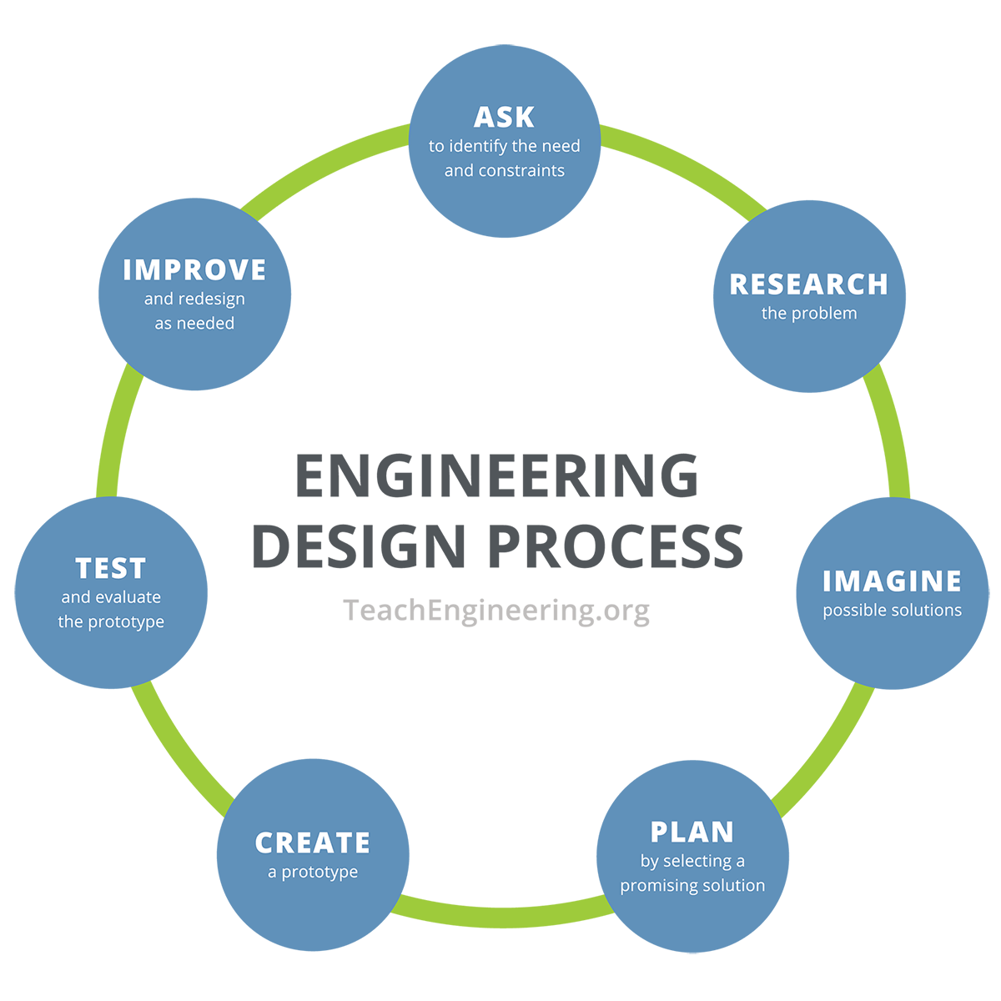
Engineering Design Process

Slide 3
EG Protolab & MakerSpace
EG Protolab has 3D printers
MakerSpace has many different machines and resources:
  Advanced 3D printers
  Laser cutter
  CNC mill
  Others
MakerSpace resources are available after finishing Orientation and may require additional training

Slide 4
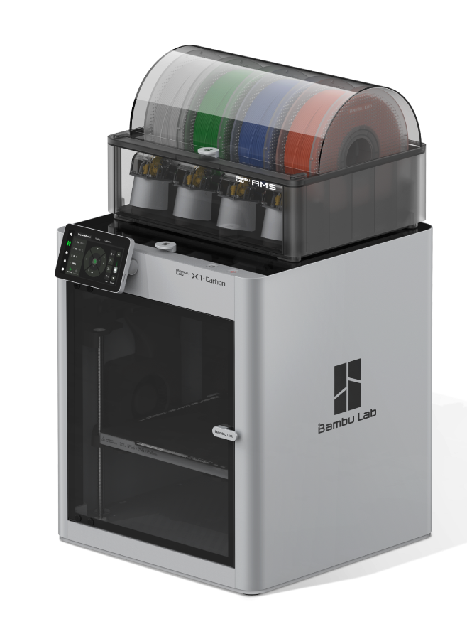
3D Printers
EG Protolab has 3D printers
MakerSpace has similar 3D printers
MakerSpace also has more advanced 3D printers
3D prints are great for custom parts
  Can’t be easily manufactured in other ways
  Special design goals

Slide 5
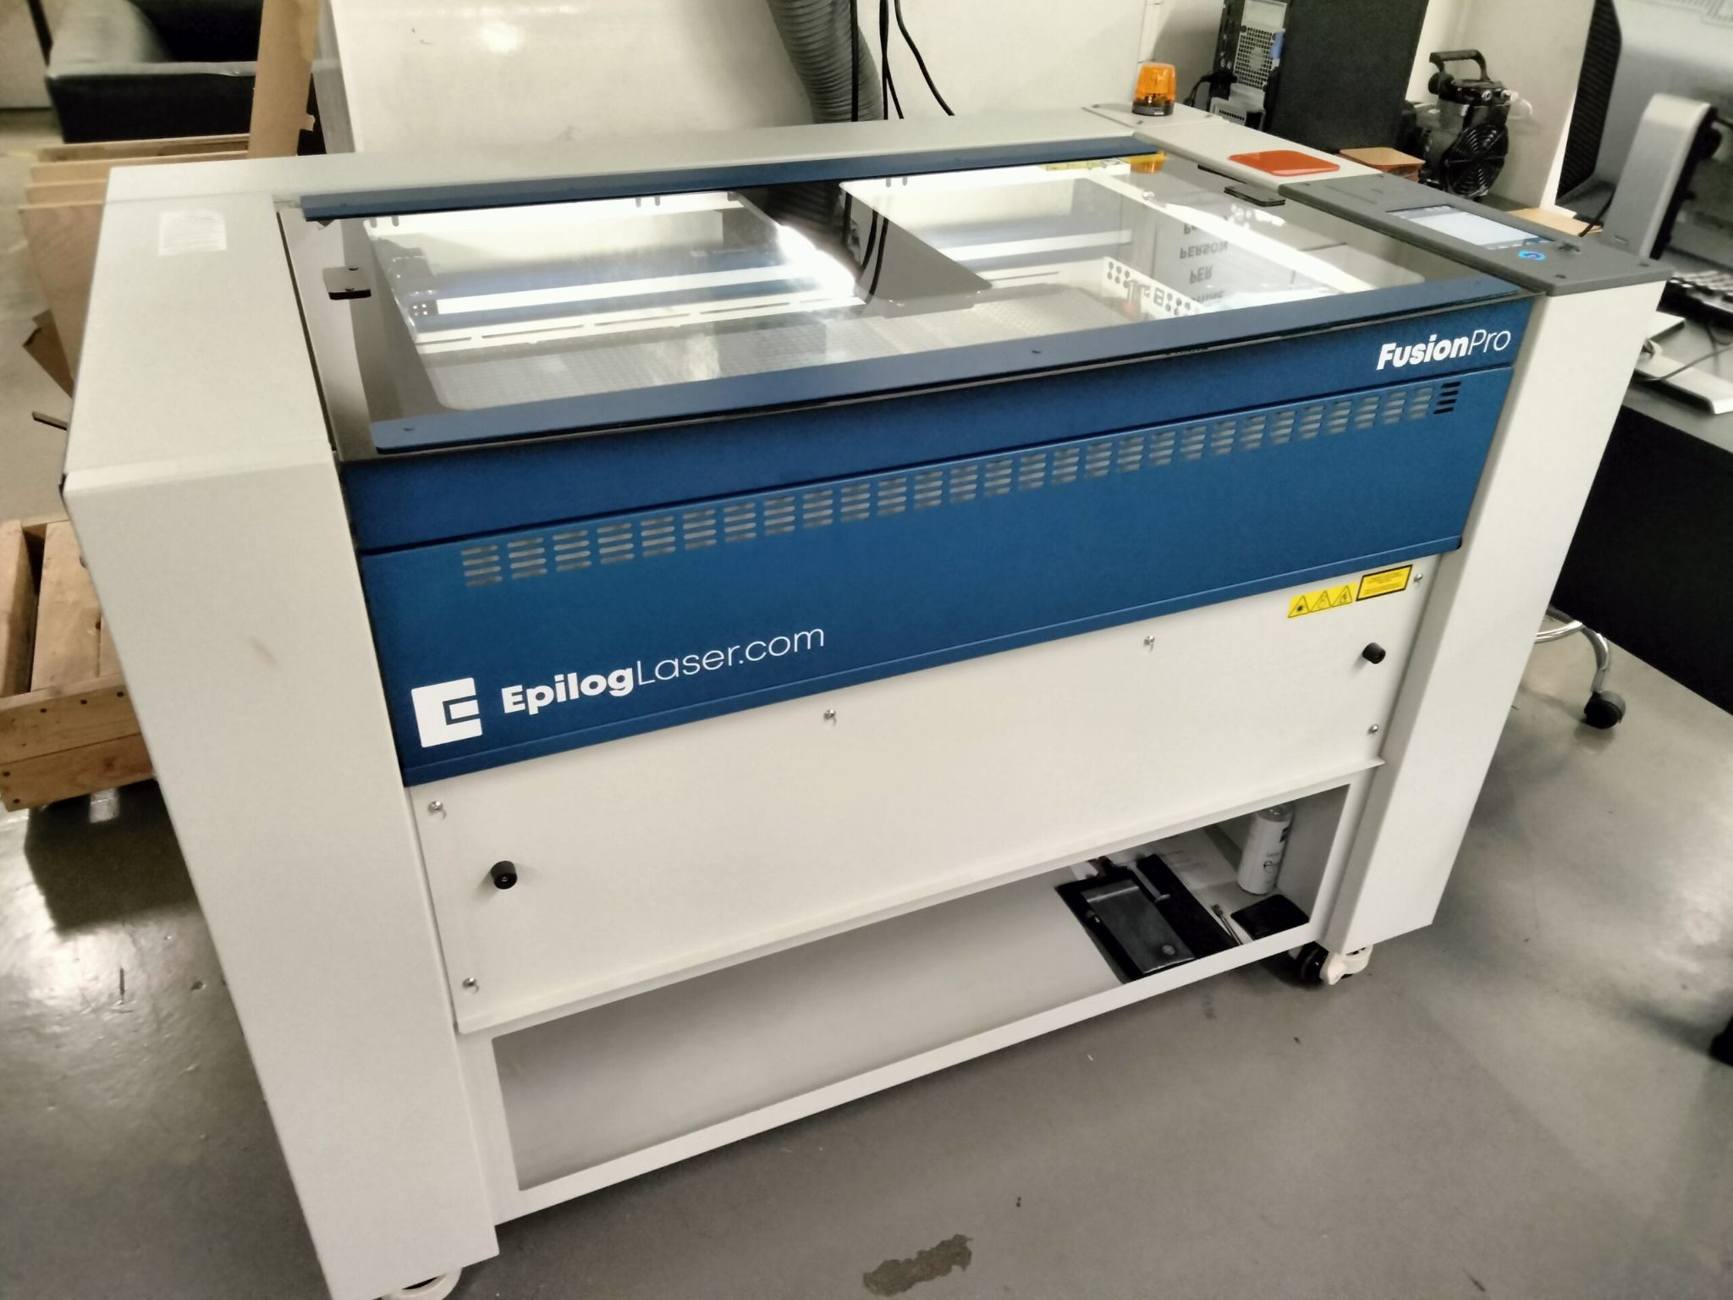
Laser Cutter
Great for large, box-like designs
  e.g. to hold electric components
  Makercase
Faster than 3D printing
Uses Adobe Illustrator to cut from material

Slide 6
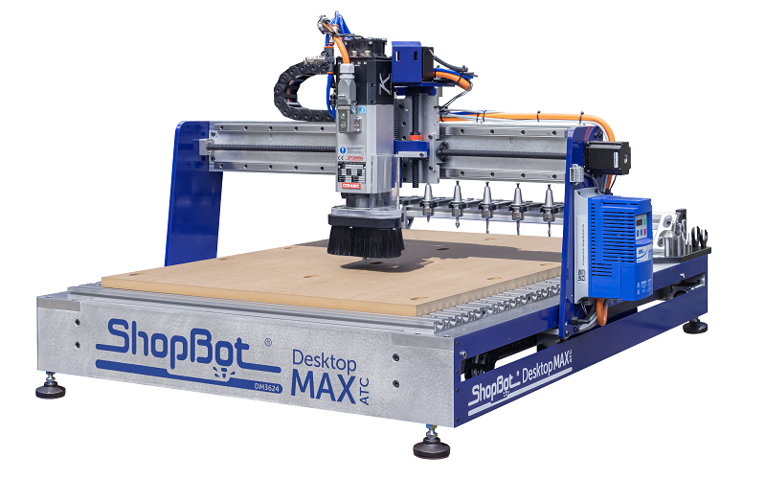
CNC Mill
Subtractive manufacturing
  Takes away from material for final product
Cut 3D shape out of material
  Wood, plastic, etc.

Slide 7
Activity
Start thinking about how to the final product will look
What types of manufacturing may you need?

Slide 8
QUESTIONS?

