Slide 1

RECITATION 5
EG1004

Slide 2
AGENDA
Algorithmic Thinking
Metacognition
Resumes
Milestone 1 Presentations

Slide 3
ALGORITHMIC THINKING

Slide 4
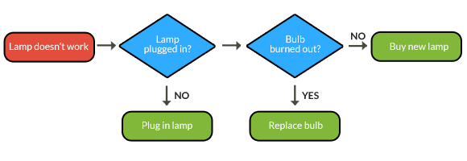
ALGORITHMS THINKING & COMMUNICATING
Notes:
The very basic foundation of software engineering utilizes logical algorithms which can be easy modeled using a flow chart -- like this one. It shows the logical process of repairing a broken lamp. A series of questions is shown in sequence whose answers determine an outcome or lead to another question.

Slide 5
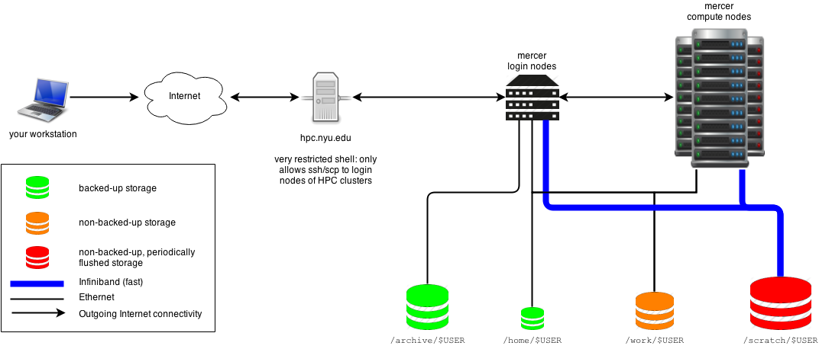
COMPUTING OPTIONS
Microcontrollers (Arduino)
Single board computer (Raspberry Pi 4)
NYU Virtual Computer Lab
High Performance Computing at NYU
Notes:
When creating electronic protypes it is important to consider the computing power and the needed functionality the prototype. The NYU Virtual computer lab is an easy way for all NYU students to gain access to NYU’s software licenses without installing an application. High performance computing at NYU is used by faculty members to aid in research and class instruction.

Slide 6
METACOGNITION

Slide 7

Notes:
Please play video. You must enable content when opening the presentation in order for the video to work. Here’s the link for the youtube video if the video does not play here: https://youtu.be/Oo5rmXL-eS0

Slide 8
Design Thinking Exercise
CATME Rater Practice
Resume
MILESTONE 1 CHECK

Slide 9





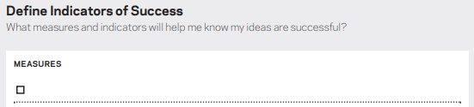

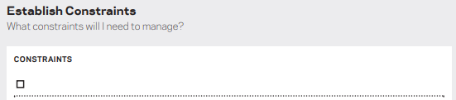

DESIGN THINKING
Notes:
The very basic foundation of software engineering utilizes logical algorithms which can be easy modeled using a flow chart -- like this one. It shows the logical process of repairing a broken lamp. A series of questions is shown in sequence whose answers determine an outcome or lead to another question.

Slide 10
QUESTIONS?

