Slide 1

RECITATION 7
EG1003

Slide 2
AGENDA
Literature Review
Connecting Engineering, Design, Analysis & Modeling
Engineering Design Canvas
1

Slide 3
LITERATURE REVIEW

Slide 4
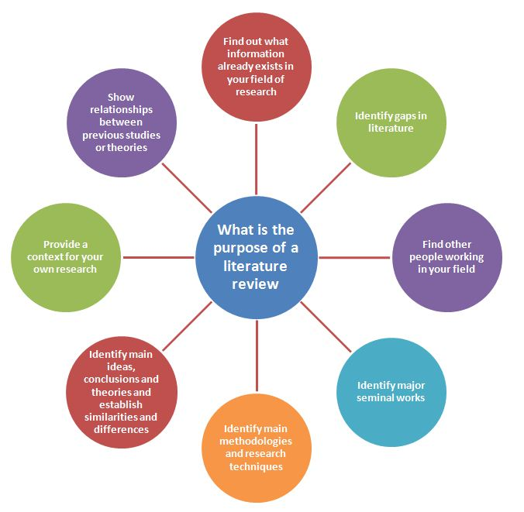

RESEARCH FUNDAMENTALS
Figure 1: Literature review purpose
courtesy of Michigan State University
3

Slide 5
CONNECTING ENGINEERING, DESIGN, ANALYSIS & MODELING

Slide 6
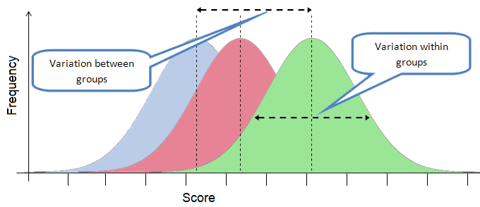
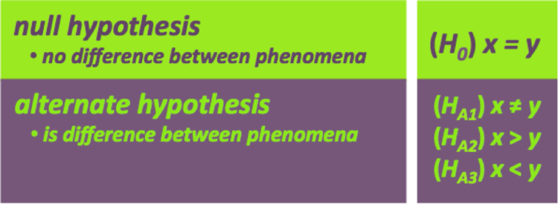
ANALYSIS
Figure 2 & 3: Hypothesis summarization and variability between groups courtesy of The Biology Primer & Warosu
5
Notes:
Depending on the set up of an experiment, either a null or alternate hypothesis could result in scientific findings and conclusion after completing an analysis. As discussed last week, the analysis of data allows summarization of the data and the bounds in which a conclusion is valid.

Slide 7
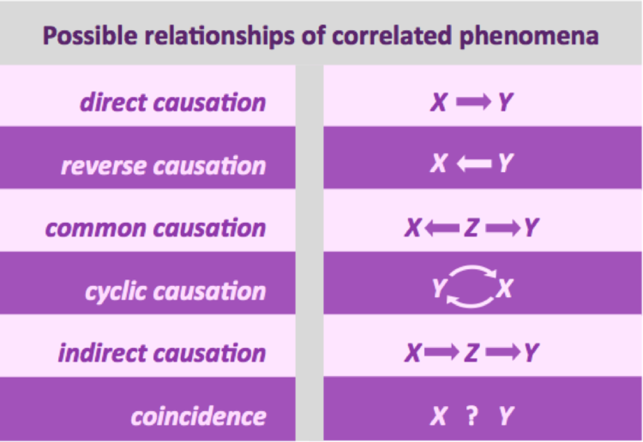
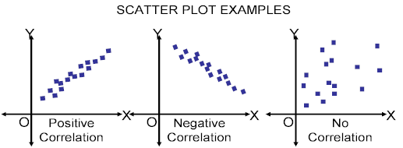
CONCLUSIONS
Figure 4 & 5: Causation and correlations courtesy of CQE Academy
6
Notes:
When forming conclusions, there are two important factors to consider: causation and correlation. Correlations show a general trend of variables in a large data set and help to form a mathematical representation from which we may be able to determine causation. Causation means that one observation is directly related to another or connected through a common agent. It is important to note that causation and correlation are not the same. If one variable changes and changes the value of the second variable, that is causation. Correlation merely states that variables are connected in some sort of way.

Slide 8
ERRORS
Small sample size (<30)
Bias (confirmation and survivorship)
Falsifiability
No peer review (not repeatable)
Statistical significance vs. practical significance
Correlation vs. causation
7
Notes:
While analysis sometimes requires a lot of statistical background, here are a few easy tips to spot errors in conclusions. A small sample size will not give you results truly representative of the population as a hole. While the minimum value of samples depends on various factors, a good rule of thumb is to think of a small sample size as under 30 samples. While it is necessary for engineers and scientists to be objective, sometimes bias slips into data analysis and conclusions. Confirmation bias uses new findings to support existing beliefs or theories without looking at the results as a whole. Survivorship bias overlooks samples that did not make it past a certain check point and only analyzing data of those samples that made it past the checkpoint. Falsifiability is the capacity for a contraction of the findings based on other evidence. Non-repeatable results sugguest that the experiment may not have been controlled or data may have been falsified. Statistical significance describes if an effect exists while practical significance explains the magnitide of an effect.

Slide 9
ENGINEERING DESIGN CANVAS

Slide 10
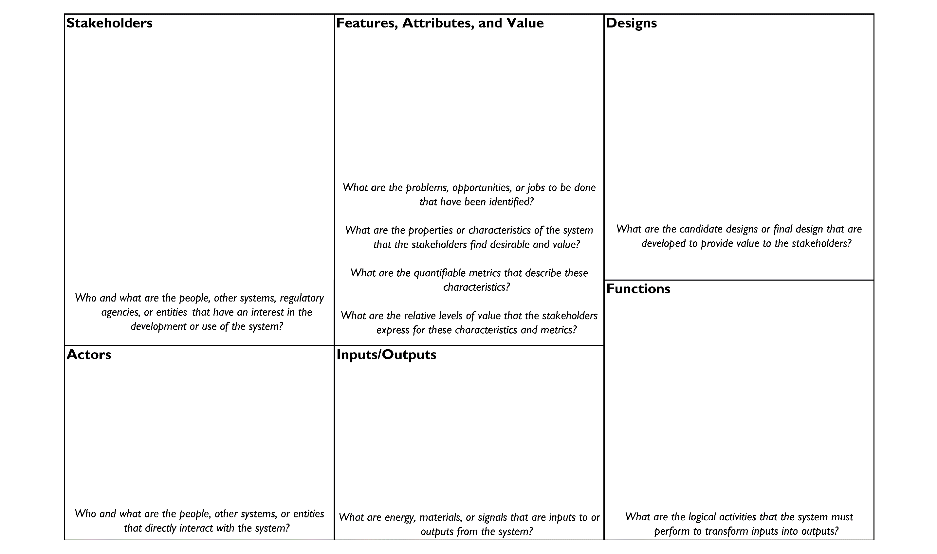
ENGINEERING DESIGN CANVAS
9
Notes:
**Have students complete this design canvas with their SLDP groups regarding their SLDP project**

Slide 11
QUESTIONS?

