Slide 1
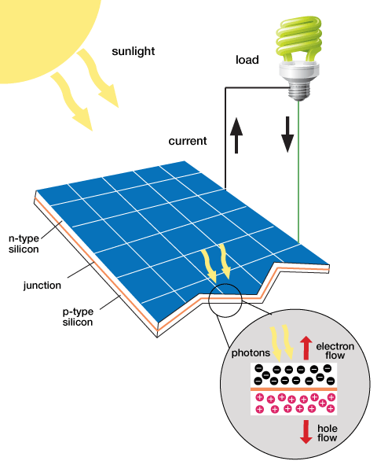
Sustainable Energy Vehicle Competition

Slide 2
Overview
Experimental Objective
Background Information
Materials
Procedure
Assignment
Closing

Slide 3
Experimental Objective
Test the capabilities of solar panels, wind turbines, and hydroelectric turbines
Test the capabilities of capacitors
Design a sustainable energy car to compete against other groups

Slide 4
Background Information
Renewable energy
Solar panels
Wind-turbine technology
Hydroelectric generation
Electronic components

Slide 5
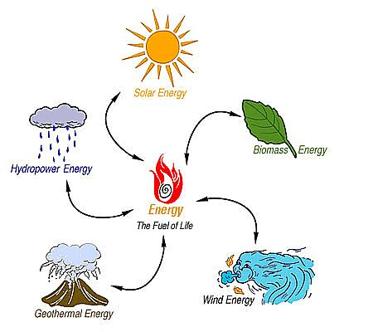
Renewable Energy
Harnessed from natural resources
Clean energy sources
Sources for energy are abundant in supply^{[1]}

Slide 6
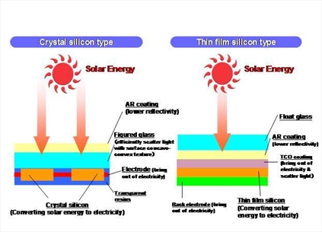
Solar Panels
Made from silicon or copper indium gallium (di)selenide (CIGS)
Converts sunlight to electrical current
Absorbed sunlight excites electrons to allow freedom of motion (generates an electric current)^{[2]}

Slide 7
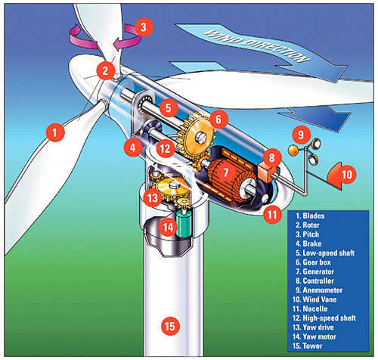
Wind-Turbine Technology
Use pressure difference generated by the wind to spin the turbine blades
Converts mechanical energy into electrical energy
The wind vane is used to determine the direction the wind-turbine will face^{[3]}

Slide 8
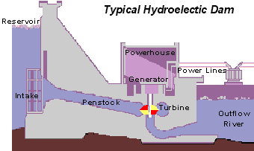
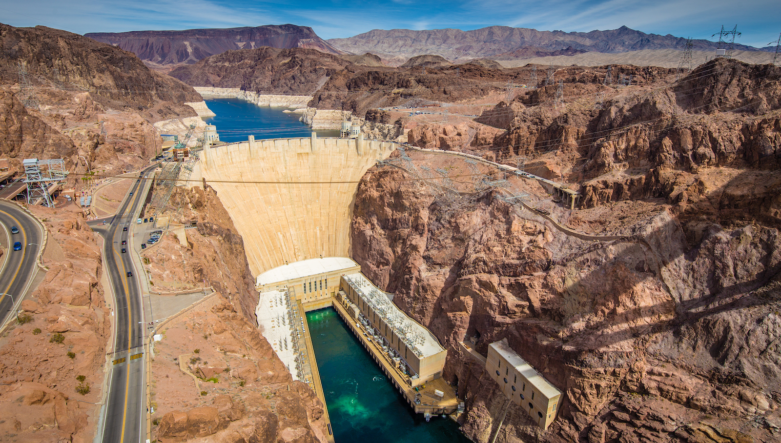
Hydroelectric Generation
Nearly identical to wind turbine
Geographically constrained
Largest source of renewable energy generation

Slide 9
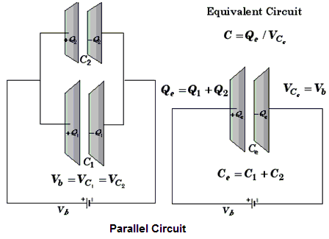
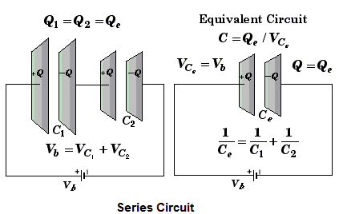
Capacitors
A capacitor is an electrical device used to store charge
Capacitors can be connected in parallel (increases charge stored) and in series (increases voltage stored)^{[5]}

Slide 10
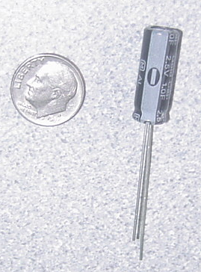
Capacitors
Store electrical energy
1 F (Farad) polarized capacitor
Positive
Negative

Slide 11
Capacitor Charging
Capacitor charge limit is restricted by charge voltage
Maximizing applied voltage maximizes energy stored
Capacitor is charged in time increments called the time constant (tau):
τ = RC
R = resistance, C = capacitance

Slide 12
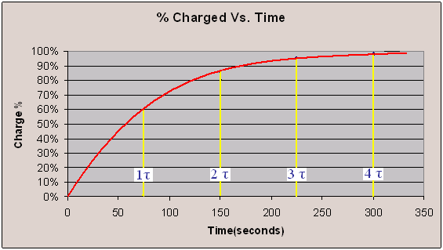
Percentage Charged
Charge is logarithmic
It takes approximately 4τ to charge the capacitor
Ex:

Slide 13
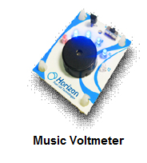
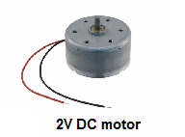
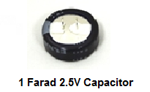
Materials
Horizon Wind-Turbine
Solar Battery Panels
Water Turbine
Adjustable Table fan
Heat Lamp
DMM (Digital Multi-meter)
Music Voltmeter
3V DC Motor
1 Farad 2.5V Capacitor
Alligator cable sets
Standard Lego Car Chassis plus Lego parts kit
Mini Electric propeller
LED (Light Emitting Diode)
Lego to Alligator Cable Clip Connector
Scissors
Tape

Slide 14
Materials Price List
Horizon Wind-Turbine ($7.50/each)
Solar Battery Panels ($10.00/each)
Water Turbine ($5.00/each)
1 Farad 5.5V Capacitor ($3.00/each)
Alligator cable sets ($0.50/each pair)
Lego to Alligator Cable Clip Connector ($0.10/each)
Duct Tape ($0.10/feet)

Slide 15
Procedure
Part 1: Test the power storage device
Capacitor
Part 2: Test the assigned power source using music voltmeter
Solar panel
Wind turbine
Water turbine
Part 3: Design a sustainable energy car using the power source of your choice and capacitors

Slide 16
Competition Rules
Power storage device must be contained in the car
The sustainable energy car may not be pushed or launched
The sustainable energy car should not be touched after it has started to move
The car will run for up to five minutes or until the car comes to a stop

Slide 17
Competition Ratio
$$CR=\frac{distance [ft]}{1 \left[s\right]+time[s]}×\frac{100}{Cost [\$]}+distance[ft]$$
Where distance is measured in feet (1 tile = 1 ft), time is time elapsed for the trial, and cost is the total cost of constructing the car

Slide 18
Assignment: Report
Team lab report
Title page
Discussion of topics in the manual
Include a picture of your vehicle
Scan in lab notes (ask TA for assistance)
TA must initial that table and graph were completed

Slide 19
Assignment: Presentation
Team presentation
State rules of competition
Describe your design and its concepts
Include table of class results, cost and photo/video of design
How could your current design be improved?
Refer to “Creating PowerPoint Presentations” found on EG website

Slide 20
Closing
Have all original data signed by TA
Submit all work electronically
Clean up workstations
Return all materials to TA

Slide 21
Sustainable Energy Vehicle Competition
QUESTIONS?

