Slide 1

PROCESSES & WATER FILTERS
LAB 8
EG 1004 Introduction to Engineering & Design

Slide 2
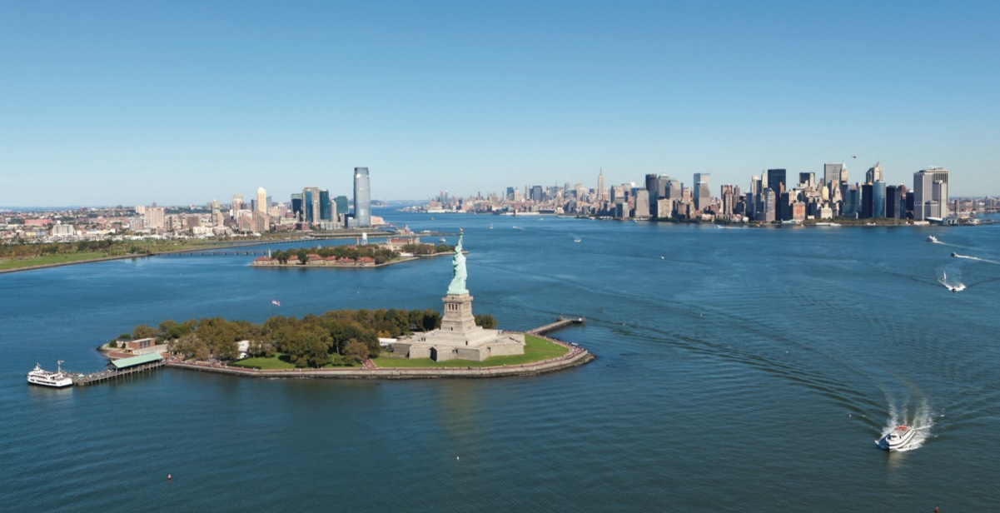
OVERVIEW
Objective
Background Information
Materials
Procedure
IDBE Implementation
Assignment
Closing
Figure 1: Hudson River Courtesy of Hudson River Foundations

Slide 3
OBJECTIVE
To understand the processes behind a water treatment system
To design and assemble an efficient water filter
To design a process flow diagram of an industrial-scale water filter

Slide 4
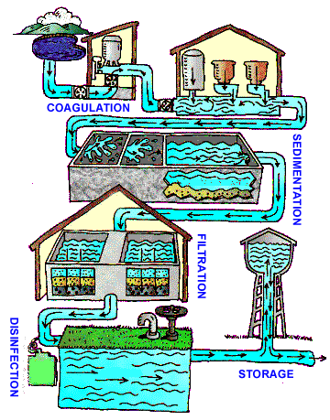
BACKGROUND INFORMATION
Water treatment system:
Coagulation & flocculation – addition of chemicals to create flocs
Sedimentation – flocs settle to bottom
Filtration – physical removal of flocs
Disinfection – kills bacteria, viruses, and parasites
Storage – store in water tank
** This lab will focus on steps 1-3 of the water treatment system
Figure 2: Water Treatment System

Slide 5
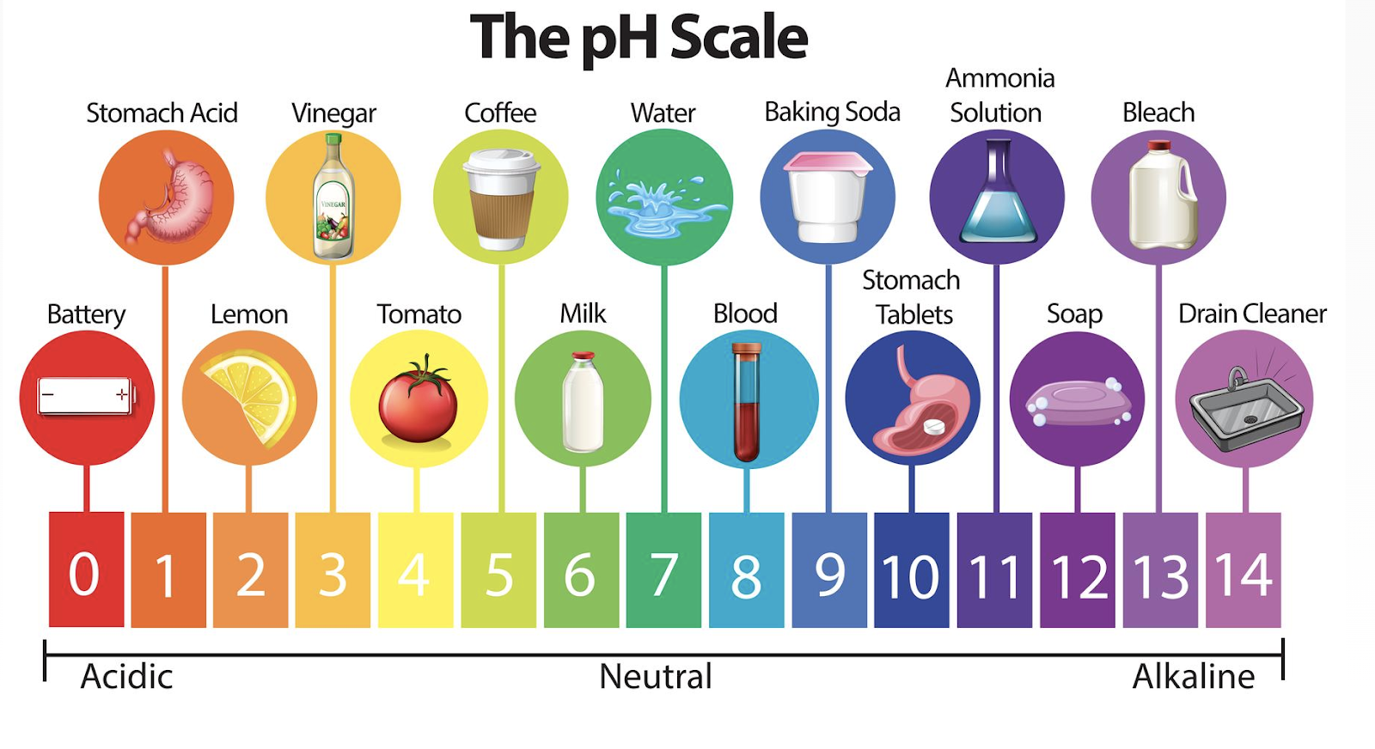
BACKGROUND INFORMATION
pH - measure of acidity and alkalinity
  Logarithmic scale of concentration of hydrogen ions
  Below 7 is acidic, 7 is neutral,
  over 7 is basic (alkaline)
  Ideal pH for drinking water is
  6.5 – 8.5
Figure 3: Example of pH

Slide 6
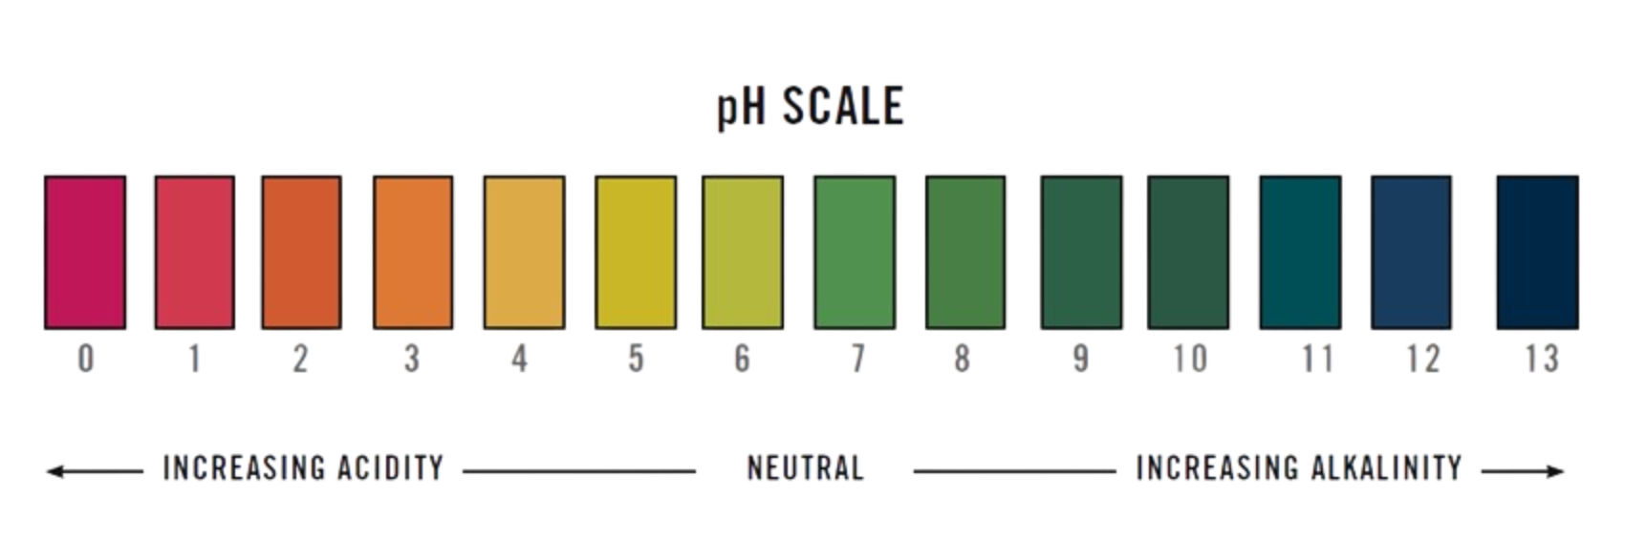
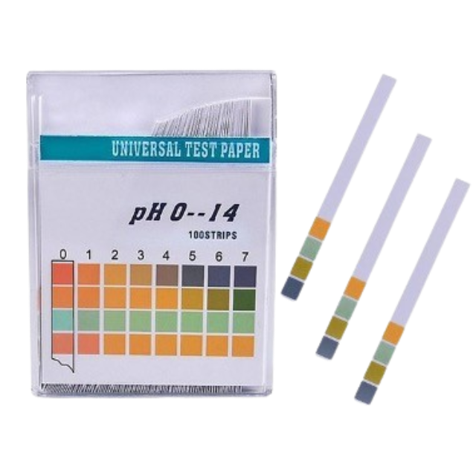
BACKGROUND INFORMATION
pH strip – strip of filter paper that changes color based of pH
Figure 4: pH Scale (left) and pH Strips (Right)

Slide 7
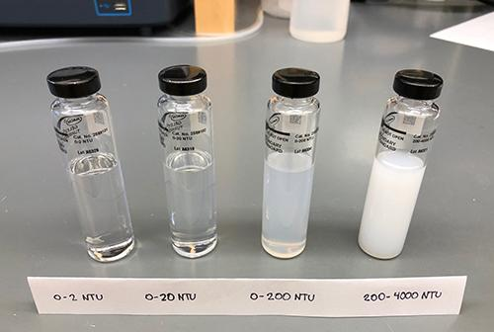
BACKGROUND INFORMATION
Turbidity - Optical characteristic of water; measure of a liquid’s clarity
  Found by measuring the amount of scattered light caused by various materials in water
  The higher the intensity of scattered light, the higher the turbidity due to particles in the water
Importance to Drinking Water: Microorganisms attached to particles are more likely to survive the disinfection process of water treatment systems
Figure 5: Water Samples of Varying Turbidity

Slide 8
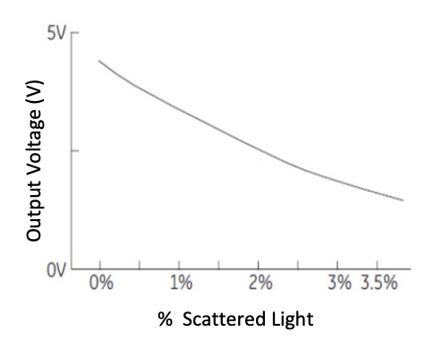
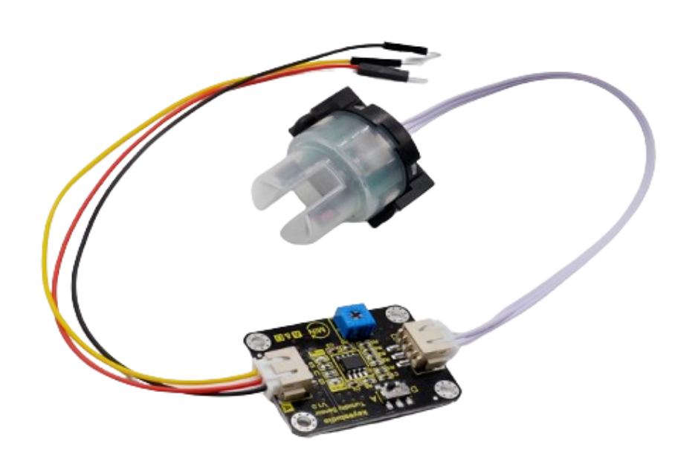
BACKGROUND INFORMATION
Turbidity Sensors
Returns the Voltage (V) of the water sample
The higher the turbidity or % scattered light, the lower the output voltage
Figure 6: Turbidity Sensor
Figure 7: Voltage vs. Scattered Light

Slide 9
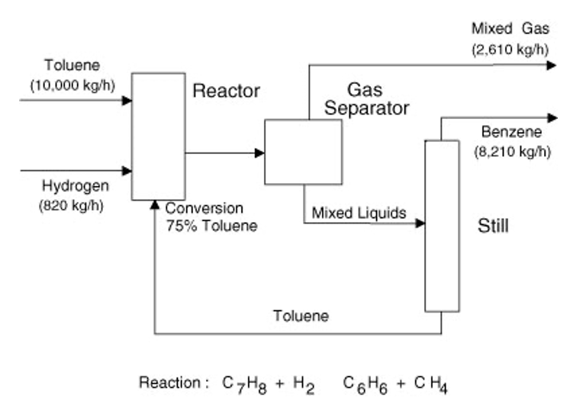
BACKGROUND INFORMATION
Process flow diagram (PFD) – relays information about a process design
Process vessel & equipment
Process and utility lines
Full energy and material balance
Composition of every stream
Bypass and recycle streams
Figure 8: Simple PFD Courtesy of InformiT

Slide 10
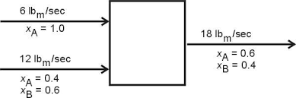
BACKGROUND INFORMATION
Mass balance – the conservation of mass applied to a process
Whatever comes in must come out
Input + Generation = Output + Consumption
Figure 9: Simple Mass Balance Courtesy of NYU

Slide 11
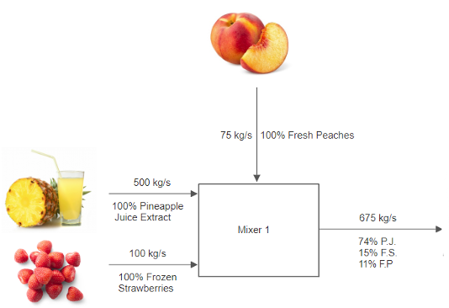
BACKGROUND INFORMATION
Example process:
Three streams enter a mixer:
  500 kg/s pineapple juice
  100 kg/s frozen strawberries
  75 kg/s fresh peaches
Figure 10: First Process Unit Example

Slide 12
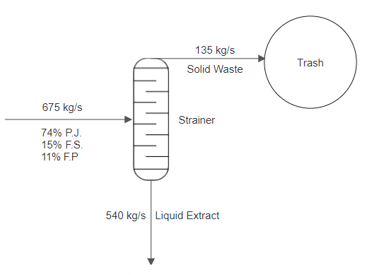
BACKGROUND INFORMATION
Next, product stream enters a strainer:
20% exits as solid and goes into the trash
80% exits as liquid extract
Figure 11: Second Process Unit Example

Slide 13
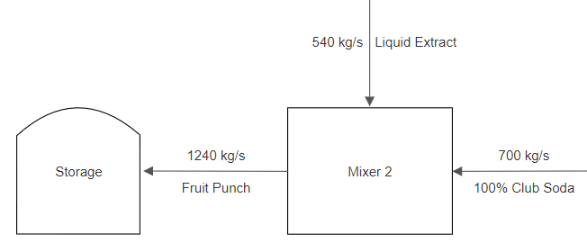
BACKGROUND INFORMATION
Lastly, liquid extract enters another mixer with another stream:
700 kg/s club soda
Product stream then enters storage unit
Figure 12: Third Process Unit Example

Slide 14
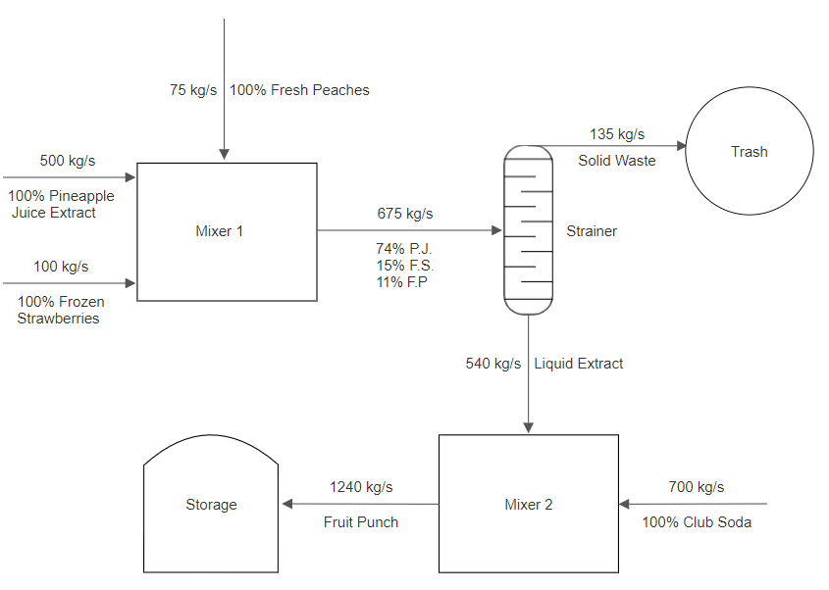
BACKGROUND INFORMATION
Combine all the parts to make the complete PFD
Figure 13: Complete Process Flow Diagram Example

Slide 15
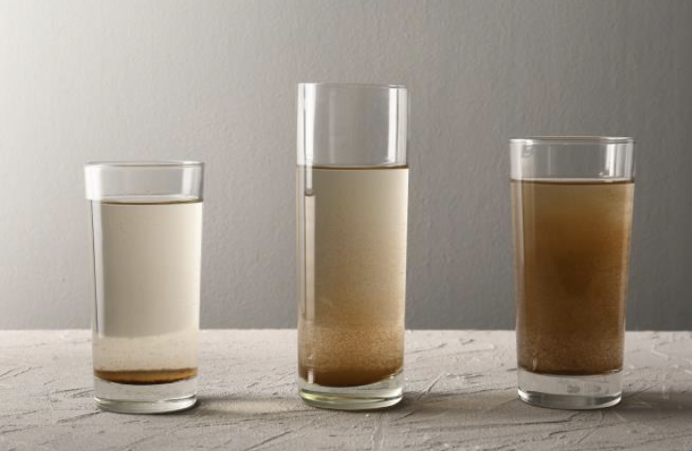
MATERIALS
Lab PC
pH strips
Contaminated water
Beaker
Funnel
Erlenmeyer flask
Scale
Alum
Sodium bicarbonate
Glass stirring rod
Gravel
Sand
Activated carbon
Turbidity Sensor
Figure 14: Turbid Water Example
Notes:
Tandon Areas of Excellence
Sustainability
Urban
Telecommunications & IT
Health
Artificial Intelligence
Professional Skills & Tandon Resources
MakerSpace & RAD
Teamwork & Vertically Integrated Projects
Career Services
Project Management & Technical Writing
World Trade Center Construction

Slide 16
PROCEDURE
Part 1: Water filter design analysis- Excel exercise
Part 2: Initial Data
Part 3: Balance the pH of the contaminated solution
Part 4: Flocculation and coagulation
Part 5: Water filter design and assembly
Part 6: Process flow diagram

Slide 17

DESIGN CONSIDERATIONS
Water filter design is judged by a Competition Equation (CE):
Design must include at least 3 scoops but no more than 6 scoops
Design must include no more than 3 scoops of each material
Only 1 Trial is allowed
$$CE=\frac{ {(Turbidity Difference)}^{3}× Flow Rate}{Cost}$$

Slide 18
DESIGN CONSIDERATIONS
Table 1: Cost List for Water Filter Design
Material | Unit | Cost Per Unit
Gravel | 1 scoop | $0.25
Sand | 1 scoop | $1.00
Activated Carbon | 1 scoop | $0.50

Slide 19
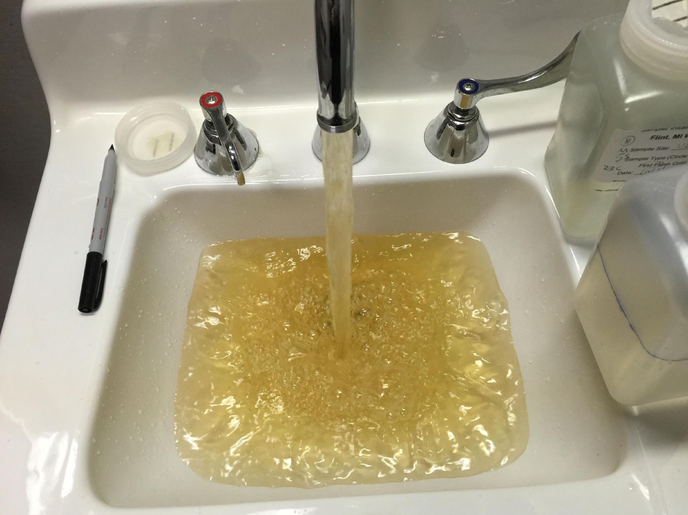
IDBE IMPLEMENTATION
Access to clean water
  Necessary for survival
  Privilege to some
  Disproportionately affects marginalized groups
Public health crisis
  Leads to other inequity issues: healthcare, education, property value
Case Study: Flint, Michigan
  A city without clean water
Figure 15: Tap Water in Flint, Michigan

Slide 20
ASSIGNMENT
Team Lab Report
  Answer discussion questions in manual
  Include pictures of water filter design & assembled water filter
  Include Excel datasheet with results
  Include picture of complete process flow diagram
  Due at 11:59 PM the night before Lab 9
Team Presentation
  Address discussion points in manual
  Include cost of water filter designs
Notes:
Tandon Areas of Excellence
Sustainability
Urban
Telecommunications & IT
Health
Artificial Intelligence
Professional Skills & Tandon Resources
MakerSpace & RAD
Teamwork & Vertically Integrated Projects
Career Services
Project Management & Technical Writing
World Trade Center Construction

Slide 21
CLOSING
Record all data in Excel datasheet
Take pictures of the filter design, assembled water filter, contaminated water, filtered water, and process flow diagram
Submit all work electronically
Clean up workstations
Return all unused materials to the TA
Notes:
Tandon Areas of Excellence
Sustainability
Urban
Telecommunications & IT
Health
Artificial Intelligence
Professional Skills & Tandon Resources
MakerSpace & RAD
Teamwork & Vertically Integrated Projects
Career Services
Project Management & Technical Writing
World Trade Center Construction

Slide 22
QUESTIONS?
Notes:
Tandon Areas of Excellence
Sustainability
Urban
Telecommunications & IT
Health
Artificial Intelligence
Professional Skills & Tandon Resources
MakerSpace & RAD
Teamwork & Vertically Integrated Projects
Career Services
Project Management & Technical Writing
World Trade Center Construction

